Slide 1
Midwest User Group Meeting
Lance LaCross, CPA
Senior Solutions Consultant
March 19, 2012

Slide 2
Agenda
Benefits of QAD Enterprise Financials
EE Financial “New Terms” Review
Components of QAD Enterprise Financials
Demonstrate Live Scenarios
Questions & Answers

Slide 3
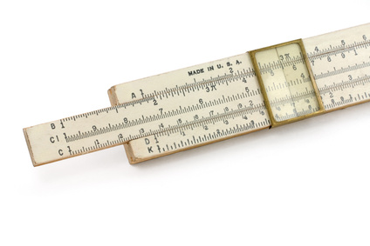
Choices of Tools?
By Harnessing The Power Of THE TECHNOLOGY, You Can Achieve YOUR Competitive Advantage

Slide 4
Business Requirements Today
Companies Need A Way To Make Sense Of All The Data Being Collected Within Their Organization – Need Increased Visibility.
Need To Be Able To Answer Strategic Business Questions.
They Are Now Being Held Accountable And Therefore Need To Control And Comply.
Companies Are Growing Worldwide And They Need A System That Will Allow Them To Benefit From Their Global Operations.
They Want A System That Is Easy To Use.

Slide 5
Upgrade Drivers Today
Can customizations be reduced ?
Can upgrade provide new business value?
Productivity
Cost
Business Justification Examines The Overall
Impact To Your Organization’s Performance

Slide 6
Benefits of Upgrading:
Take Advantage Of New Functionality
Reduce Customizations
Reduce Operational Costs
Respond To Globalization And Consolidation Needs
Increase User Productivity
Ensure Compliance
Optimize Application And System Performance
Drive Lean Principles Throughout The Organization
Notes:
6

Slide 7
Leverage Technology
Powerful Functionality To Import/Export Data
Bi-directional Excel Integration Example

Slide 8
Key Accounting Areas
Transactional Posting
Internal Control / Compliance
Analytics / Reporting

Slide 9
New Enterprise Edition Concepts
More, faster and better:
Database - Shared Set
Entity = “Balanced Set of Books”
Domain = Group of Entities with same Base Currency
Layers or “Books”
Statutory Currency
Daybooks = Source Identifiers
Supplementary Analysis Fields = SAF
Intercompany vs. Cross Company
G/L Account (Components)
Business Relationships
Master Files – Suppliers, Customers, etc
More …

Slide 10
Database Structure
Enterprise Edition
Shared Set Data
Domain Data
System Wide Data
Shared Set Data
Domain Data
Domain Data
Entity Data
Entity Data
Entity Data
Site Data
Site Data
Location
Site Data
Location
Location
Entity Data
Site Data
Location
Site Data
Location
Location
Site Data
Location
Site Data
e.g. Currency,
users, languages, countries …
e.g. COA, suppliers, customers, …
e.g. Base currency, statutory currency, operational controls, …
e.g. Taxes, security numbering, …
e.g. Inventory, costing,
planning, …

Slide 11
Shared Sets
Eleven Data Elements That Are Published As A Shared Set:
GL Account
Sub-Account
Sub-Account COA Mask
Cost Center
Cost Center COA Mask
Project
Project COA Mask
Supplier
Customer
Daybook
Exchange Rate

Slide 12
Shared Set Benefits
Enterprise Edition
Americas
Domain YEN
Corporate EE Database
Europe
Domain USD
Domain CAD
Suppliers
Chart of Accounts
Customer
Exchange Rates
Asia / Pacific
Domain EUR
Domain MXP
Chart of Accounts
Domain GBP
Domain CHF
Domain AUD
Domain CNY
Suppliers
Customer
Exchange Rates
Chart of Accounts
Suppliers
Customer
Exchange Rates
Chart of Accounts
Suppliers
Customer
Exchange Rates
Chart of Accounts
Suppliers
Customer
Exchange Rates
Chart of Accounts
Suppliers
Customer
Exchange Rates
Chart of Accounts
Suppliers
Customer
Exchange Rates
Chart of Accounts
Suppliers
Customer
Exchange Rates
Suppliers
Customer
Exchange Rates
Chart of Accounts

Slide 13
GL Analytical Coding Segments
Entity
Yr/Pd
Layer/Book
Daybook
header level
Primary GAAP Acct
Sub-Account
Cost Center
Project
SAF’s
SAF’s
SAF’s
SAF’s
SAF’s
line level
Up to five ‘supplementary analysis fields’ on a posting line
Intercompany key
can automatically retrieve SAF data from Operational transactions
Site
Product Line
Region (Customer)
Customer Type
Supplier Type
Item Type
Item Group
Allows - actuals in value (in tc, bc, sc)
actuals in quantities
budgets
Open item key
Other GAAP Account
Other GAAP Account
extra keys on line level

Slide 14
Accounting Layers / Books
Enterprise Edition
Accounting layers (books) provide ways of segregating transactions within a single GL account.
The posting of transactions is controlled by associating daybook types with one of three system-defined accounting layers: official, management, and transient
G/L
Transactions
IFRS
Layer
Mgmt
Layer
“What If” Layer
Local GAAP Layer
Audit Layer
Official Layer = SE
Notes:
14

Slide 15
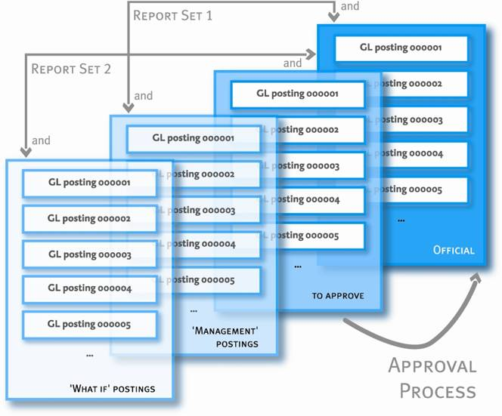
Accounting Layers and Reporting
Reporting can be based on:
One single layer
A combination of layers
Layer combinations for reporting can be stored as user preferences
An account can have a balance for each layer

Slide 16
Daybooks (Journal Identifiers)
Daybook
Layer Type
Layer / Book
Official
Management
Transient
IFRS Adjustment
Auditor
US GAAP Adjustment
“What If”
Journal Entry
Banking
Year-End Close
Etc.
Accounts Payable
All transaction posting lines are recorded in daybooks (journals) for ease of summarization.
Journal Entry “Identifiers” – filter and search capability
Multiple daybooks are possible
Daybooks can be assigned to any of the accounting layers

Slide 17
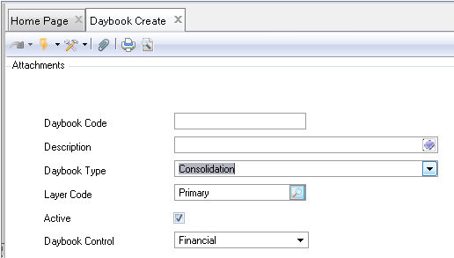
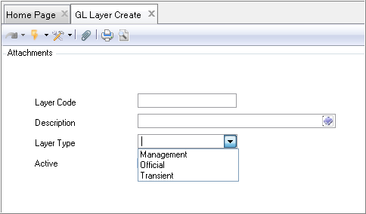
Daybook & Layer (Book) Relationship
The Daybook Code is tied to the Layer Code. So a Journal Entry Daybook transaction can drive the detail to a specific layer in the GL
17

Slide 18
Business Relation
Each customer, supplier, entity, and employee is linked to a business relation code
Defined at database or domain level
Can be created when creating a new customer or supplier
Business Relations have different address types – up to 6 types:
- Head office - Ship-to - Reminder | - Remittance - Dock - End User

Slide 19
Business Relation Hierarchy
Customers
Business Relationship
Suppliers
Employee
Business Relationship
Corporate Group
Inter Facility 1
Business Relationship
Business Relationship
Corporate Group
Inter Facility 2
Customers
Suppliers

Slide 20
Data Exchange Options in QAD
QXtend -Third Party Apps
XML – Web Data
XLS – Excel
Manual
EDI
eCommerce
Integrated Customization Toolkit
CSV – Comma Separated Value

Slide 21
Back to Live Software…
GL Account Setup Choices
Journal Entry Drill Down

Slide 22
QAD Reporting - Matching Need To Solution
Executives
CEO, COO, CIO, CFO
QAD Business Intelligence
- Long term trend analysis
Both QAD and non-QAD data
Easy access (web, mobile)
Strategic
Dept. Managers
Finance, Mfg., Sales,...
Tactical
QAD Enterprise Applications
Inquiries & Standard Reports
Operational Metrics
Reporting Framework
Browses & Collections
Operational
Operations
Prod. Mgr, Planners
Warehouse, Staff

Slide 23
Different Flavors of Information
Local
GAAP
IFRS
US
GAAP

Slide 24
QAD Reporting Considerations
Flexible Reporting Options:
Browses:
Ad Hoc Browses
Standard Browses
Collections
Metrics
Reporting Framework
Standard Reports
Variant Concept
Structured Reports
Variant Concepts
Excel Integration
SAF – Supplemental Analysis Fields
New Financial Reporting (2102)
Consolidation Views
Business Intelligence

Slide 25
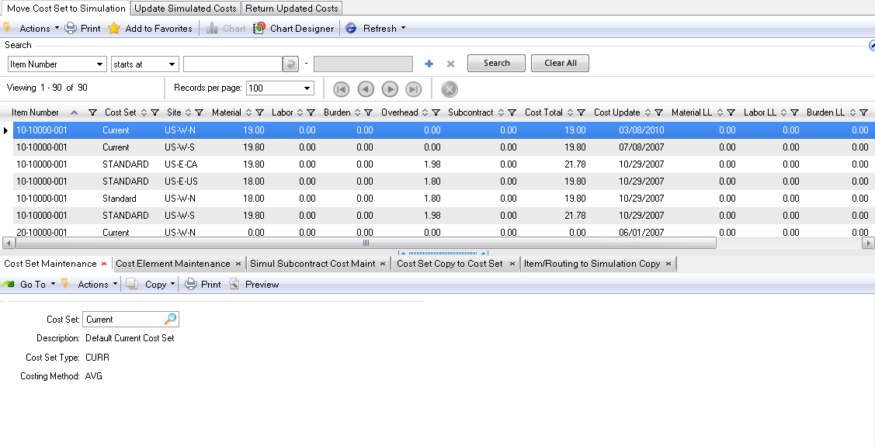
Workbenches, Browses, Collection
Pre-set with user ability to change and create new

Slide 26
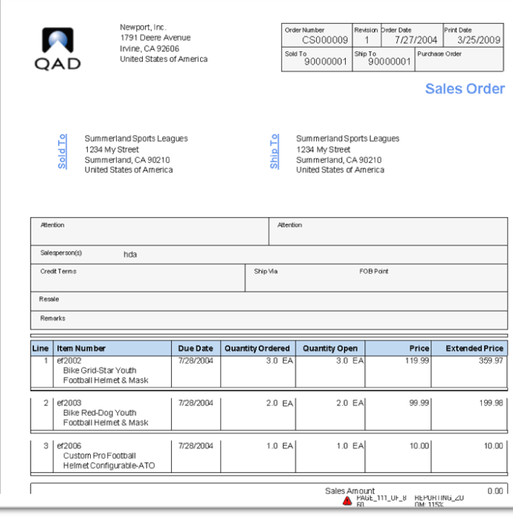
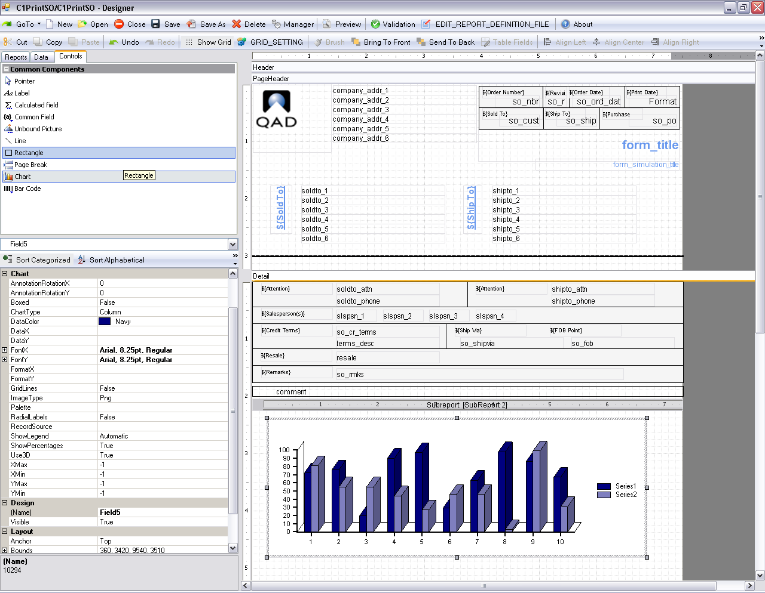
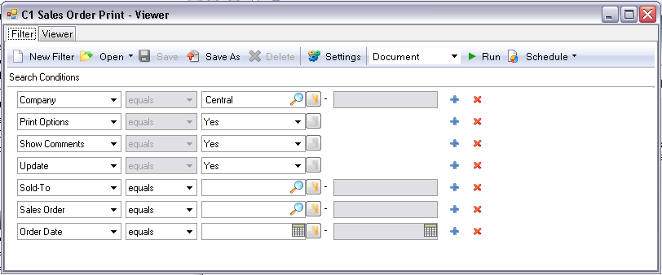
Reporting Framework
Create New, start with Browse, or modify Existing QAD reports
Add images, graphs and other controls
Additional Features
Windows Task Manager Schedules
Output documents, Excel, PDF
Release with QAD EA includes samples
Existing reports converted over time
26

Slide 27
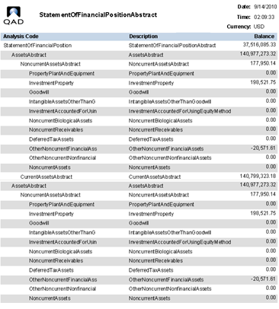
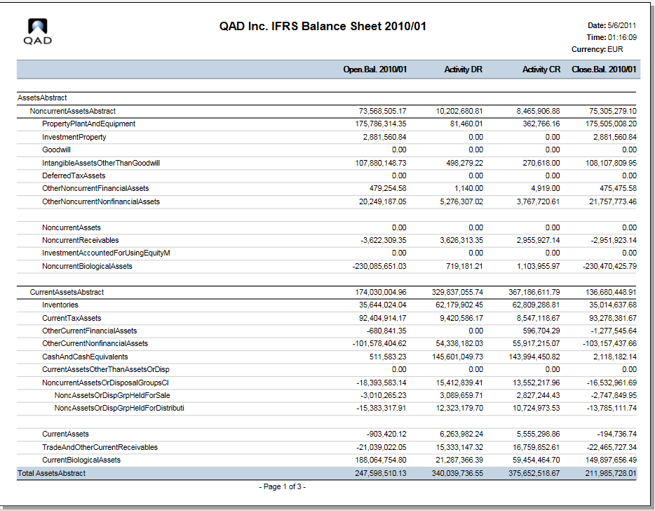
Group Reporting - Financial Report Writer
Reports / Analysis
Report
Cube
Common Report Chart
-GL
-Sub-Account
-Cost Center
-Project
-SAF
Presentation Currency
Report Calendar
27

Slide 28
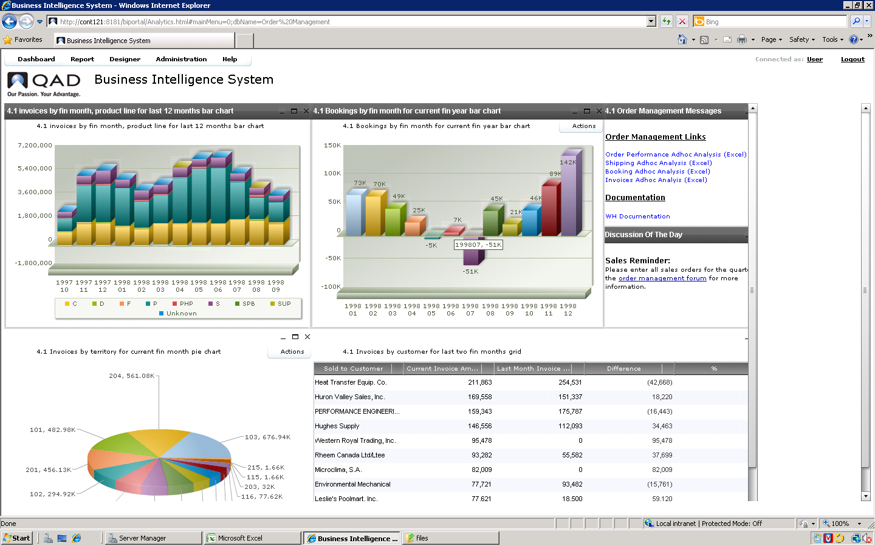
See the Whole Picture

Slide 29
Back to Live Software …
Report Variants
Reporting Framework Example
Trial Balance View

Slide 30
QAD Multi-GAAP
Accounting Layers allow for multi-GAAP reporting
Multiple charts of accounts (COA) for reporting purposes
Ability to combine accounting layers in reporting
Simulate GAAP transformation transactions
Allocation module and Supplementary Analysis Fields to support IFRS segment reporting
Accounting layers allow multi-GAAP reporting from a single set of books

Slide 31
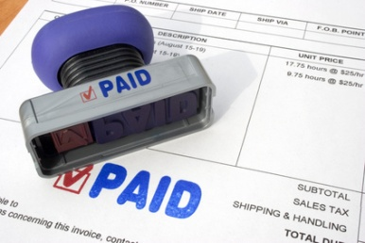
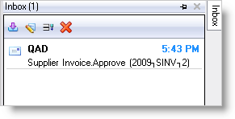
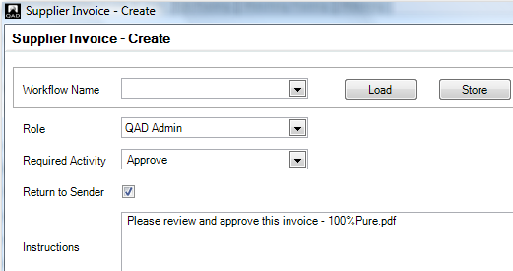
Financial Shared Services
Sharing of chart of accounts and other key master data
Sharing of customers and supplier across business units
Workflow to move documents between business entities
Link to document management to store electronic versions of paper documents such as invoices
Cross-company AR and AP payments
More efficient use of resources – better management of cash
Have economies of scale to save back-office costs and support growth

Slide 32
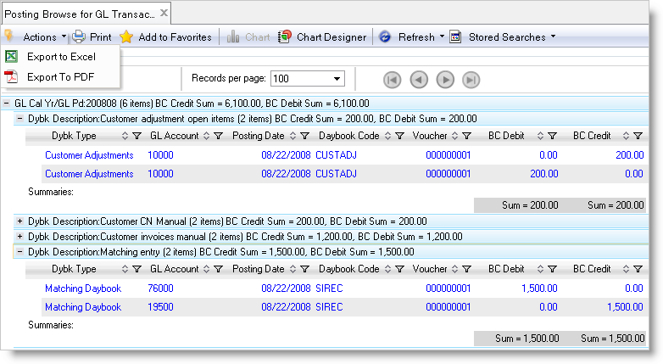
QAD General Ledger
Multi-Entity, Multi-Currency, Multi-Layer
Support for recurring/reversing entries
Extensive drill-down capabilities
Flexible account structure with up to 5 optional Supplementary Analysis Fields per account combination
Posting templates
Multi-stage period closing process including period marks, closing validations and reporting
Separate period for year-end corrections
Bi-directional Microsoft Excel® integration for journal entries as well as for account setup
Ensures all financial data is quickly accessible for drill down and corporate reporting

Slide 33
SAF – Supplementary Analysis Field Hierarchy
Structure – 1 Per Account
Concept Up to 5 per Structure
Unlimited Codes
Concept Up to 5 per Structure
Concept Up to 5 per Structure
Unlimited Codes
Concept Up to 5 per Structure
Concept Up to 5 per Structure
Unlimited Codes
Unlimited Codes
Unlimited Codes

Slide 34
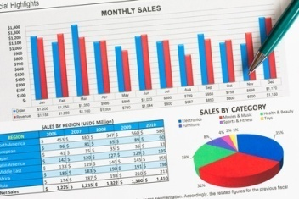
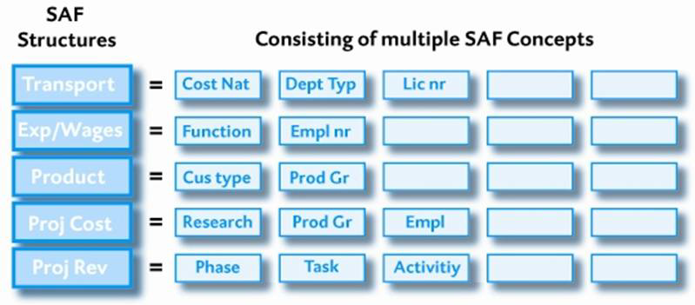
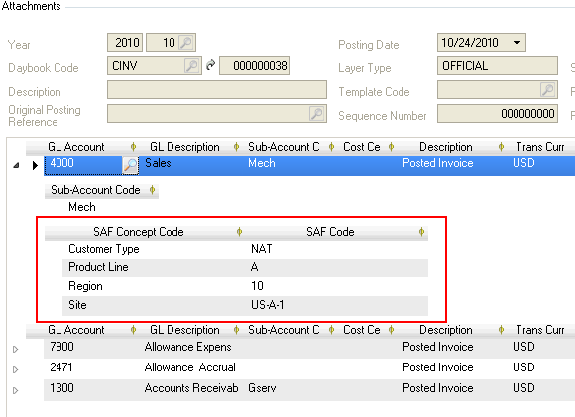
SAF Structures
SAF codes can be defaulted to make data entry easier

Slide 35
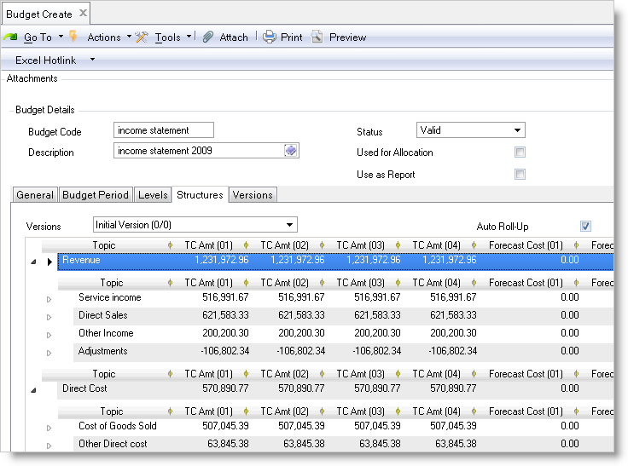
QAD Budgeting
Supports multiple versions of budgets
Budget periods can be different from accounting periods
Recording of forecasts
On-line budget checking and warnings
Import budget data from Microsoft Excel®
Live modification of budgets using Microsoft Excel®
Supports multi-level budgeting and actuals coming from multiple companies
Quick, flexible, collaborative budgeting process for the finance manager

Slide 36
Back to Live Software…
Budget Example – Bi Directional Excel Integration

Slide 37
Consolidations
A subsidiary entity can be a part of multiple consolidation entities
Proportional Consolidation is supported
You can build up hierarchies of consolidation entities
Automatic tracking of intercompany transactions to support elimination
Consolidate separately by accounting layer
Support simulations
Provides quick & complete consolidation process for the Finance Manager
Notes:
Multi-Level consolidation
Hyperion

Slide 38
Management Example
US Locations
Chicago, IL
Dallas, TX
Miami, FL
Los Angeles, CA
New York, NY
Canada
Germany
China
Mexico
Eliminations Entity
International Sales
ABC World Wide

Slide 39
Legal Example
ABC World Wide
ABC Domestic Entity, Inc.
Eliminations Entity
Acme Industries, Inc.
XYZ GMBH
CBA International Ltd.

Slide 40
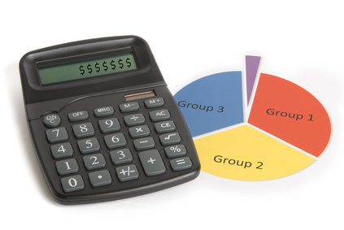
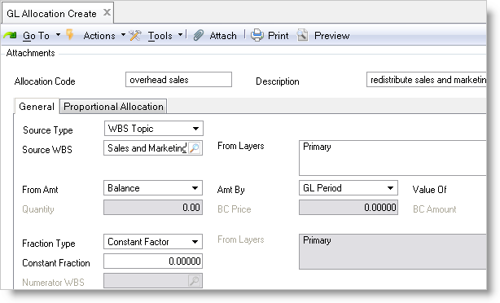
Allocations
Distribute costs and revenues to
appropriate accounts, sub-accounts,
cost centers and projects
Supports recursive allocations
Reuse result of previous allocation run as input for the next
Validate results of allocation run before final posting
Supports different allocation methods, including proportional based on usage/activity
For instance distribute electricity costs to production centers/departments based on kWh
Allocation provides control and consistency

Slide 41
Allocation Definition
Fraction
Numerator
Source
Target
*
=
Denominator
Source can be a constant, a runtime entered value or a GL posted value (defined in Budget WBS [Work Breakdown Structure] as ‘topic’)
Numerator / Denominator can be constants, runtime entered values or GL posted values (defined in Budget WBS as ‘topic’)
Target is your allocation posting, based on a Journal Entry template

Slide 42
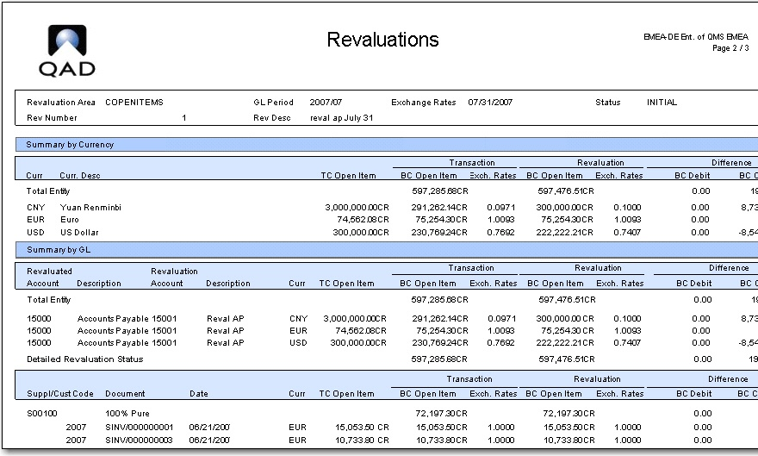
QAD Multiple Currency
Process, pay and receive money in any currency
Set up functional currencies by business unit
Multiple Currency Types
Dual Base Currency Plus
Transaction amounts always stored in transaction currency + in primary base (functional) currency and secondary base (statutory) currency
Extensive revaluation options, both for functional and statutory currency
Allows a global organization to conduct business any currency, and generate consolidated and management reporting in the mandated currency
Do business in any currency

Slide 43
Multiple Base Currencies
Dual Base Currency: Transaction amounts always stored in transaction currency, base currency and statutory currency
For example:
Customer invoices
In CAD (transaction)
In MXN (base)
In USD (statutory)
MXN
For example, a Mexican company keeps its books in MXN, reports into a US parent company and sends a CAD invoice to a customer
Notes:
43

Slide 44
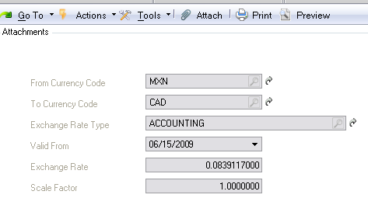
Define Exchange rates per type
Per type
Per currency pair
From validity date
Notes:
44

Slide 45
Translating Financial Statements of Foreign Affiliates
Translation: the conversion of financial statements from one currency to another
Translation

Slide 46
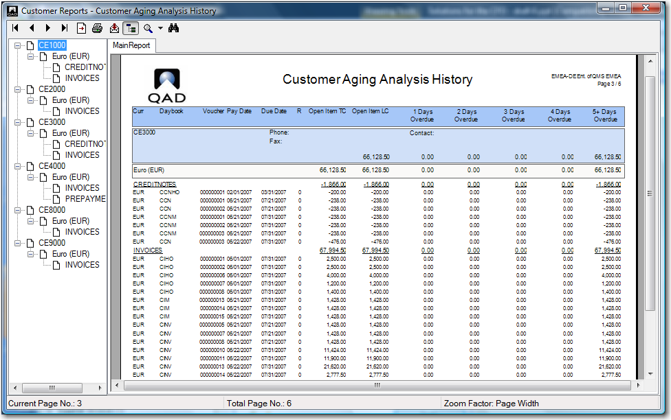
QAD Accounts Receivable
Flexible aging reports
Retro Billing allows price changes on items after items shipped and invoiced
Self Billing
Sharing of customers and credit limits between business units
Automatic netting of invoices and credit notes
Netting between common customers and suppliers
Write-offs and open item adjustments
Dunning letters automatically generated
Customer activity dashboard
Full control on the total process between billing and collecting

Slide 47
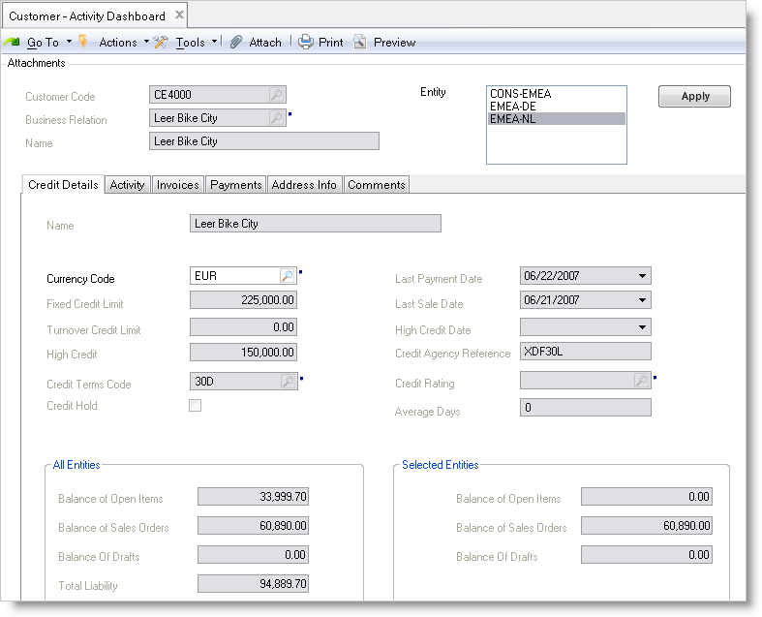
QAD Credit Management
Extensive and flexible credit check (Days & Dollars)
Based on percentage of sales
Fixed credit limit
Maximum days of overdue
Option to overrule
Share credit limit of shared customers across companies
Configurable warning level
Dashboard for customer activity and credit information
Multi level dunning letters
Ensures visibility of customers with credit issues for the finance manager

Slide 48
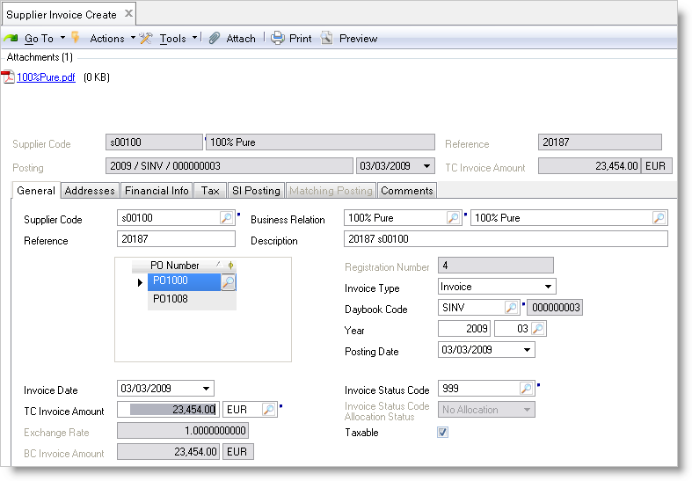
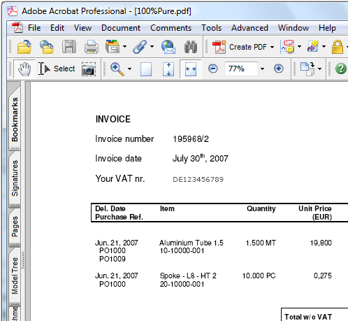
QAD Accounts Payable
Variances are generated based on 3-way match of PO, receipt and invoice
Flexible matching and approval process
Automate process of entering and approving supplier invoices with Scan daemon, document management and workflow routing
Evaluated Receipts Settlement (ERS) eliminates the need to enter supplier invoices
Netting between common customers and suppliers
Write-offs and open item adjustments
Supplier activity dashboard
Streamline the process from purchase order to supplier payments

Slide 49
Back to Live Software …
Common Master Files Structures
Supplier Master/Customer Master
Supplier Invoice Creation
Supplier Payment

Slide 50
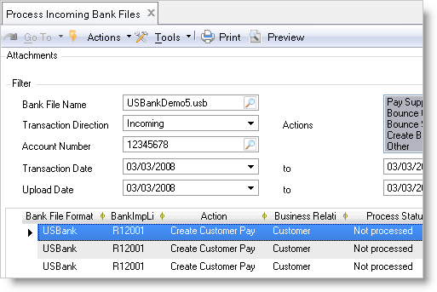
QAD Banking/Cash Management
Electronic import of bank statements
Supports US Lockbox processing
Extensive support for automated payments, including drafts and direct debit
Support for local payment and file formats using QAD Internationalization
Flexible mapping of payment formats using EDI eCommerce
Petty cash handling
Bank account validation according to local formats including IBAN
Automatic monitoring of cash flows to quickly make key decisions based on the cash position of the business

Slide 51
QAD Tax Management
Allows global tax treatment for multiple tax environments in the same database
Unlimited number of tax types and rates
VAT, luxury, capped, non-recoverable
Considers
Geography
Item status (taxable, non-taxable)
Customer / Supplier status
Effective date
Includes flexible reporting
API between Vertex Sales Tax
Serves the different sales, use and VAT taxes globally
Ensures correct tax registrations and smooth tax reporting

Slide 52
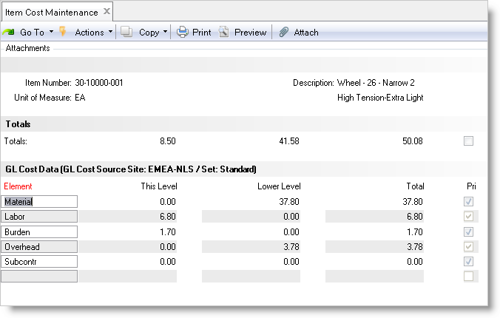
QAD Cost Management
Supplements standard costing model to allow actual cost analysis
Powerful tools to model and implement cost changes to standard costs
Set up cost structures as required for the corporation or make them unique by plant by utilizing unlimited cost sets, multiple costing methods and cost elements
Unlimited Cost Simulation
Accurately costs parts and track variances to standards based on flexible cost components

Slide 53
Expanded - Periodic Costing (2010)
Expanding Current Functionality:
Periodic revaluation of item costs based on all inventory/shop floor transactions occurred during that period supporting following calculation methods:
Weighted Average (WAVG)
FIFO
LIFO
Generation of GL Transactions for all related transactions based on new calculated item cost
Complete versus standard costing plus adjustments
Inventory Valuation based on WAVG, FIFO LIFO calculated item unit costs
Absorption of Indirect costs
Absorption of expenses (Freight, Insurance, …)

Slide 54
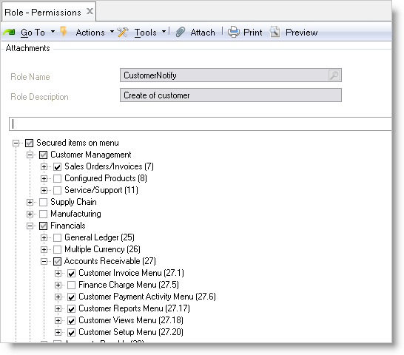
QAD GRC (Governance, Risk, & Compliance)
Extensive set of solutions for Governance, Risk and Compliance
Minimizes costs of compliance to government regulations such as Sarbanes-Oxley, IFRS and other governance requirements
Extensive automated controls
Enhanced Audit Trails
Have full audit trail capability for data changes
Tracks who made a change, when the change was made what are the prior and new value
Role based security up to activity level
Trade compliance using QAD TMS
Access control including forced password complexity, aging and intrusion detection
Helps companies stay compliant

Slide 55
Role Based User Interface/Security
Define Roles and Permissions
Segregation of Duties:
Define conflicting roles
User Interface depending on Role

Slide 56
Security Segregation Of Duties
Implementation of 2 rules:
Rule 1 (Role permissions) All the application resources to which any given role grants access must belong to compatible segregation of duties categories.
Rule 2 (Role membership) All the assigned roles to a given user, must have compatible segregation of duties categories.
The system should be able to verify both of these rules readily, and present the results in a report.

Slide 57
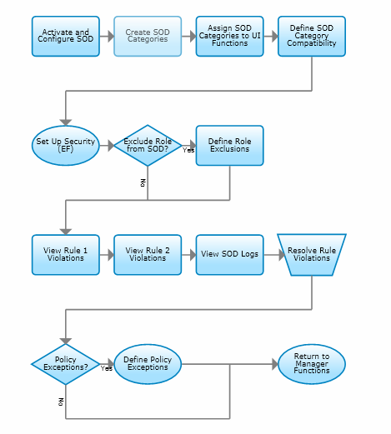
Segregation Of Duties Flow

Slide 58
QAD Fixed Assets
Multiple and user defined depreciation methods
Ability to split and combine assets
Support transfers and retirements
Multiple concurrent depreciations to support different GAAP requirements
Helps in supporting regulations such as Sarbanes-Oxley
Accurately manage and track fixed assets throughout their lifecycle: from asset acquisition to disposal

Slide 59
Fixed Assets Components
Fixed Asset Component
Books
Detail
Multiple Depreciation Books (GL, Tax, etc.)
Asset Component Maintenance
Options: Retire, Transfer, User Fields, Comments, & Insurance Data
Options Detail

Slide 60
Fixed Asset Integration
Capital Project
Manage Project
Asset completed with associated value
Project Action Capitalization
Identify Asset Number
QAD Fixed Asset
New Asset passed to Fixed Asset module
Acquisition cost
Location
Class
Track all Cost
Trailing Charges
Asset depreciation
Cost basis adjusted

Slide 61
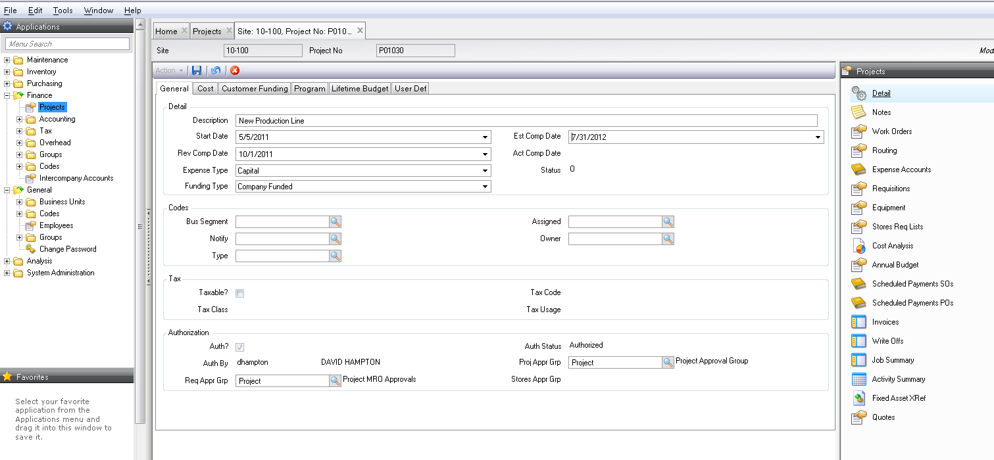
Project Detail

Slide 62
Fixed Asset Integration
Features
Utilized existing Fixed Asset data information set in Fixed Assets
EAM’s Project module collects all asset cost
EAM’s Project costs are mapped into FA module creating a FA record
Asset basis adjustments are captured automatically
Customer benefits
Integration point between Project and Fixed Assets
Provides a direct link between EAM’s Project Accounting module to Fixed Asset module
Timely and accurate updates
Removes inaccuracies
Notes:
EAM’s existing Project Accounting Module manages and collects all cost associated to a Capital project. Now EAM’s Project module integrates with QAD’s core Fixed Asset module specifically for EE releases. The integration automatically creates the Fixed Asset including acquisition cost based on EAM’s total project cost. The FA capitalization process can be reviewed and completed by finance. Additional project cost can also be automatically sent to adjust the asset basis as needed.
This feature provides a new integration point between EAM and QAD Enterprise Application which enhances the current integration between the two systems. This feature benefits our customers by providing a seamless integration, removing the required manual update in Fixed Asset which takes time, and errors could easily be made in transposing the data. Also, any changed to the capitalized amount is also handled seamlessly for the user.

Slide 63
QAD Internationalization
Support common local legal business practices across the world
Support local languages – Unicode on one database
Standardized solution as opposed to unique solution for each country
Single code base: easier development of core model
Support Shared Services from a single system
Keep up to date with new and changing local requirements
Run QAD across the globe

Slide 64
Questions / Answers

Slide 65
Reminder
Please fill out your survey so we may continue to improve these events for you.
Thank You!

