Slide 1



Optimized Billing for
B2B Billers

Slide 2










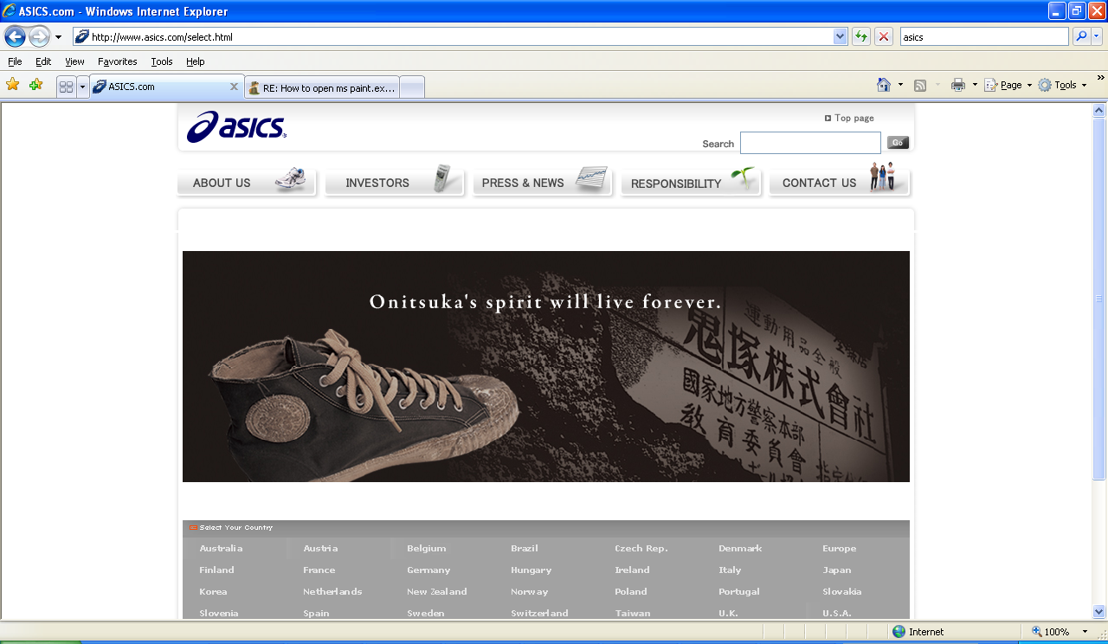











Billtrust – QAD’s Partner for Billing Services
"I love reporting my billing costs every month because they are going lower and lower! In the first four months after going live with Billtrust, our e-billing rate grew from 25 % to 65%."
Peggy Kemp, Manager of Credit and Collections, Saint-Gobain Performance Plastics, OH

Slide 3
Today’s Speakers
Tom Scott VP Sales, Billtrust
Peggy Kemp, Manager of Credit and Collections, Saint-Gobain Performance Plastics, OH

Slide 4

About Saint-Gobain Performance Plastics
Business unit of Saint-Gobain Ceramics & Plastics Inc., a subsidiary of Compagnie de Saint-Gobain.
Advanced-technology polymer products for the industrial applications
Shared Service group covering 9 different business units.
HQ in Aurora, OH
Went live in April 2009

Slide 5




Who is Billtrust?
Billtrust is a Business to Business Billing Specialist
Founded in 2001 by billing industry veterans
450 customers, 300 are distributors or manufacturers
Approved Service Provider for 15 associations, user groups and buying groups
99% annual customer retention

Slide 6
Billtrust CompleteBilling ™ Service
A Complete Business To Business Solution
Paper Billing
Invoice Gateway
(EIPP)
Billing Services
Bill Design
In-Bill Marketing
E-Adoption
Reporting
Email Billing
Customer Care
(CSR Access)
Fax Billing

Slide 7

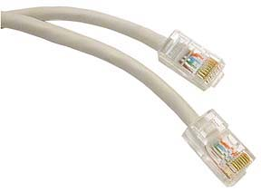
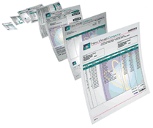
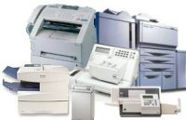
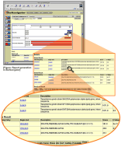
How Does CompleteBilling Work?
1
Billing information is entered
into QAD as usual.
Instead of printing, folding, stuffing, and mailing bills;
billing data is sent to Billtrust for processing
2
3
Billtrust’s SmartRouting™ technology determines the preferred way to deliver the bill to your customer: mail, email, fax or web.
4
Billtrust machines print bills; fold, insert, and seal envelopes; deliver to post office in one day, Monday - Saturday - guaranteed
5
Confirmation report is sent to customer detailing total items processed by delivery channel (mail, email, fax, web)

Slide 8
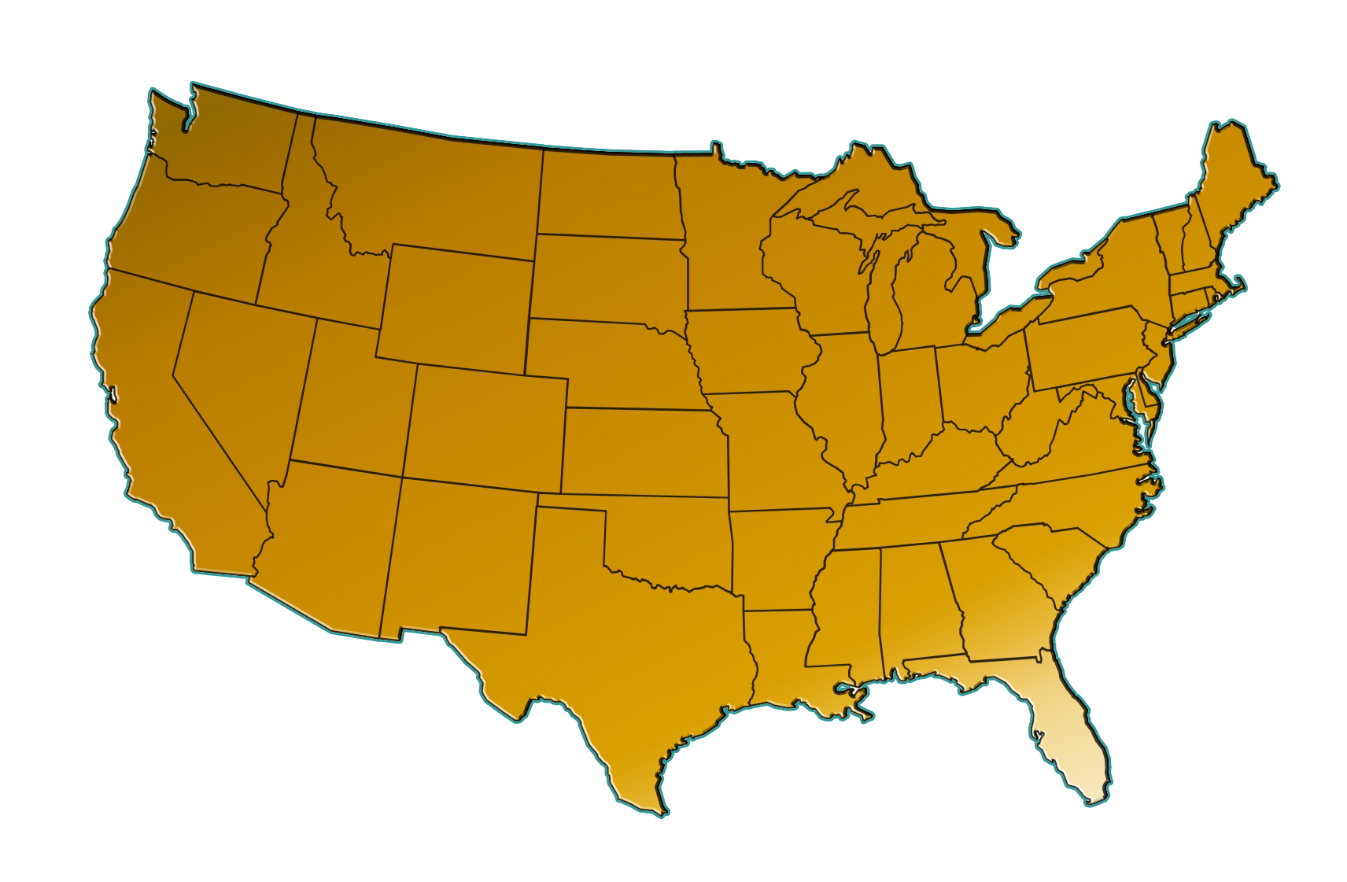

SmartRouting™
Mail speed is optimized based on location of bill recipient
Toronto, Canada
Canadian Processing
Portland, OR
Northwest Processing
Chicago, IL
Midwest Processing
Jamesburg, NJ
Eastern Processing
Sacramento, CA
Southwest Processing
Jacksonville, FL
Southeast Processing

Slide 9
Top 4 Reasons B2B Billers Choose Billtrust
Significant Cost Savings
Dramatically Improved Quality
Increased Customer Retention
Accelerated Cash Flow
1
2
3
4

Slide 10
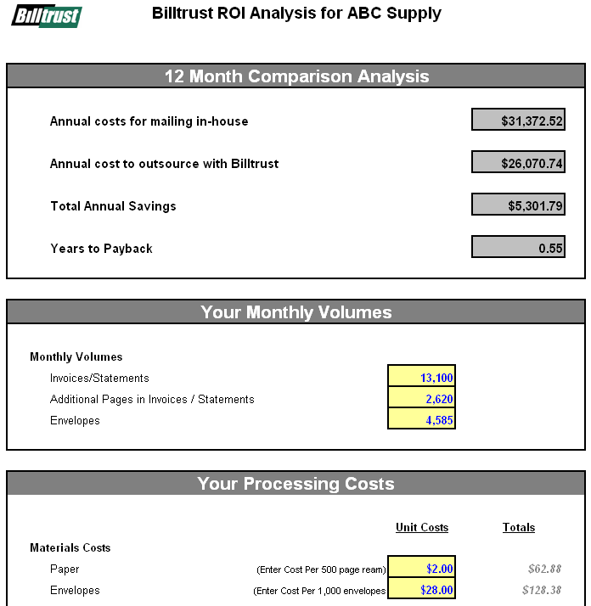
Evaluating the Cost Savings
Materials
  Paper/Preprinted Forms
  Ink
Postage
Equipment
  Printers
  Folders
  Inserters
  Postage Machines
Labor
Management Time

Slide 11
Evaluating the Cost Savings
Why is Billtrust more cost effective?
1. Materials Volume purchasing of materials, no pre-printed forms required
2. Postage Certified and bar-coded addresses qualify for maximum postage discounts
3. Labor Mail process almost entirely automated utilizing high speed printing and insertion equipment
4. Technology Maximized Page Layout, Bill batching, Bullpenning
5. Email / Ebill Billtrust advanced technology and adoption programs deliver even bigger savings over time

Slide 12

Batching
Combining different bills destined for the same billing address into one envelope to reduce postage and envelope costs
Without Batching
INVOICE
INVOICE
Cost Estimate
ABC ELECTRIC
ANYTOWN, USA
ABC ELECTRIC
ANYTOWN, USA
2
x $.50
$ 1.00
Invoices
Per Envelope
Total Charges
$15.26
$15.26
With Batching
INVOICE
INVOICE
Cost Estimate
ABC ELECTRIC
ANYTOWN, USA
ABC ELECTRIC
ANYTOWN, USA
1
x $.50
$ 0.50
1
x $.05
$ 0.05
$ 0.55
Invoice
Per Envelope
First Bill Charge
Additional Page
Per Page Fee
Extra Pages Charge
Total Charges
$15.26
$15.26

Slide 13
Bullpenning
Holding bills that are below a dollar threshold for a specified number of days to reduce postage and materials costs
Monday
Tuesday
Wednesday
Without Bullpenning
INVOICE
INVOICE
INVOICE
Cost Estimate
ABC ELECTRIC
ANYTOWN, USA
ABC ELECTRIC
ANYTOWN, USA
ABC ELECTRIC
ANYTOWN, USA
3
x $.50
$ 1.50
Invoices
Per Envelope
Total Charges
$15.26
$125.47
$475.99
Monday
Tuesday
Wednesday
With Bullpenning
Cost Estimate
INVOICE
INVOICE
INVOICE
ABC ELECTRIC
ANYTOWN, USA
ABC ELECTRIC
ANYTOWN, USA
ABC ELECTRIC
ANYTOWN, USA
1
x $.50
$ 0.50
1
x $.05
$ 0.10
$ 0.60
Invoice
Per Envelope
First Bill Charge
2 Additional Pages
Per Page Fee
Extra Pages Charge
Total Charges
$15.26
$125.47
$475.99
< $250
< $250
You control: Dollar Threshold, Maximum Hold Days, Accounts to Exclude, Statement Day(s) to Mail All

Slide 14
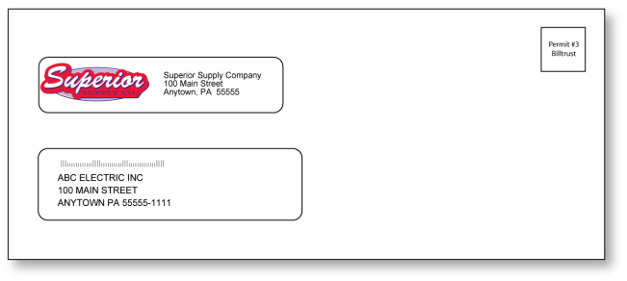

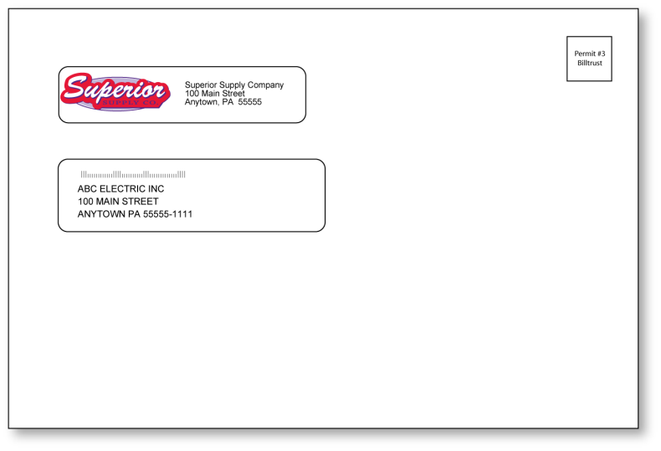
Using the Right Envelope at the Right Time
1-5 pages
13-55 pages
# 10
Flat
6-12 pages
6 x 9
6 x 9’s save 65 cents on each envelope and are delivered faster

Slide 15
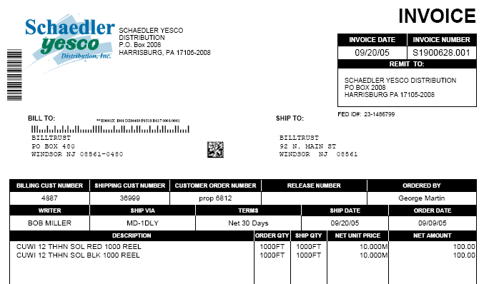
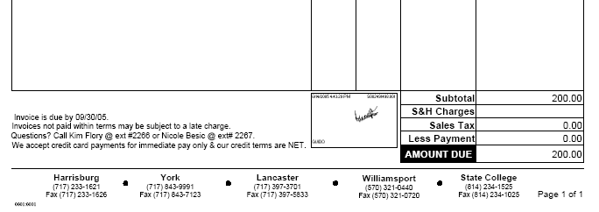
Quality Starts with a Well-Designed Bill
Variable logos for different divisions
Clear titles for invoices and credit memos
Billtrust forms make customization a
snap
Easily incorporate
captured signatures

Slide 16
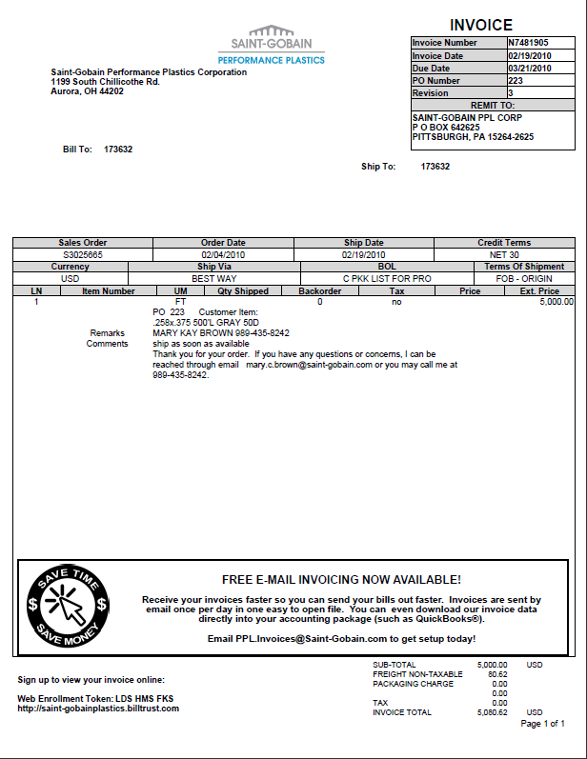
Saint Gobain Bill Design
16
Notes:
Messaging
16

Slide 17
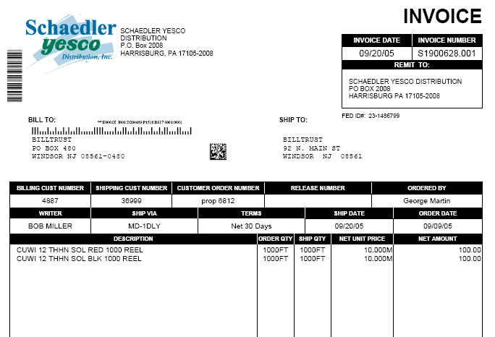


Mail Piece Integrity
Bar-coding on each bill contains a count of pages per envelope and a sequence check to prevent incorrect inserts
Permit #3
Billtrust
Cameras at the end of the insert process take a picture of this 2-D barcode to guarantee that every piece is accounted for

Slide 18
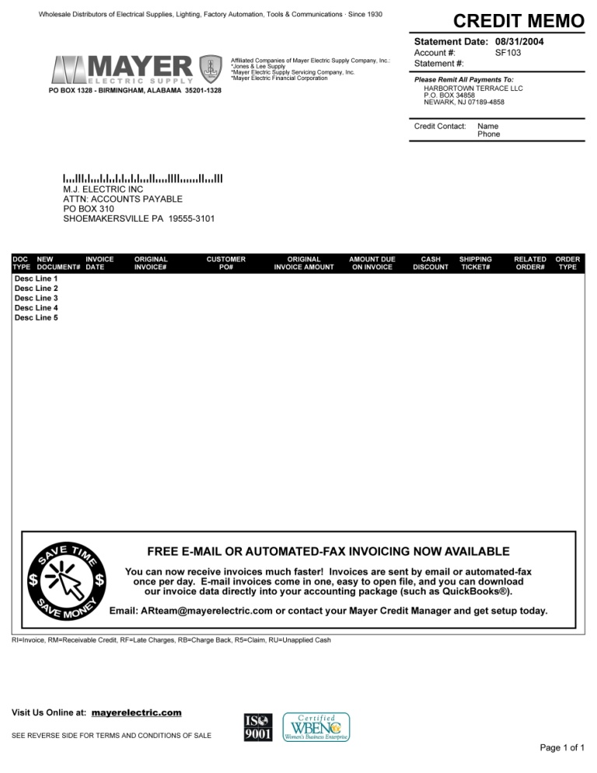

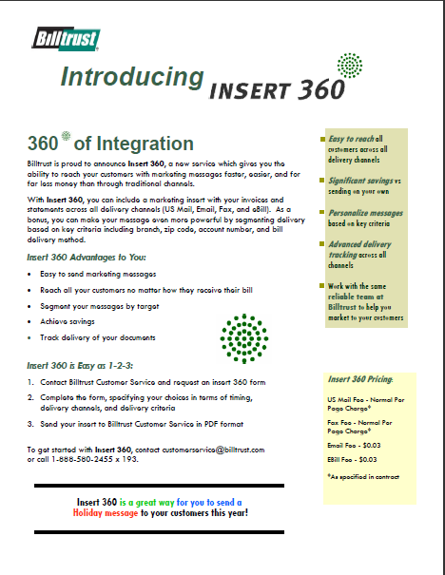
Bill Marketing with Billtrust
Dynamic Bill Message
Pre-Printed Inserts
Insert 360

Slide 19
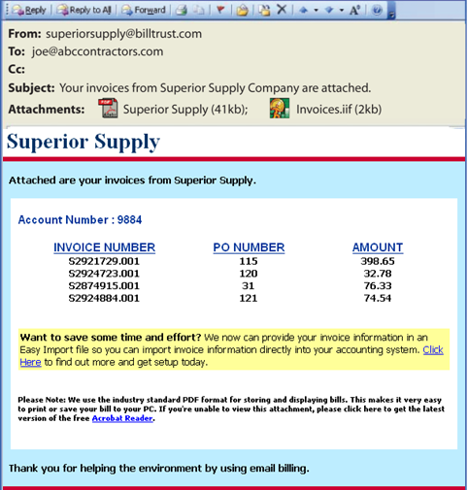
Email with Easy Import
Only ONE e-mail per day per customer
Easy Import files let your customers import invoices instead of re-keying them
Exact replicas of each bill in a SINGLE PDF file
Invoices and statements clearly summarized in the body of the email
“We love getting our invoices and statements by email with the downloadable file. I can access the data files from different places and it has saved us countless hours of manual data entry.”
- Patty Webb, Webb Electric, an electrical contractor client of Stoneway Electric

Slide 20
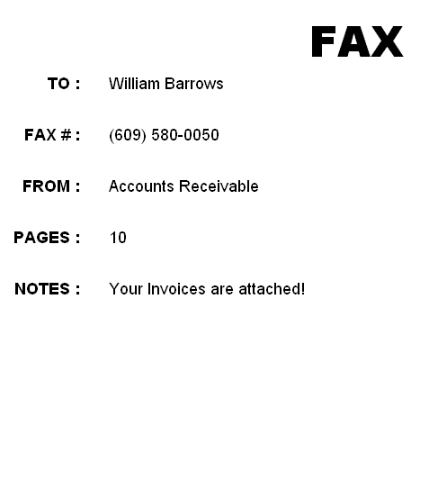
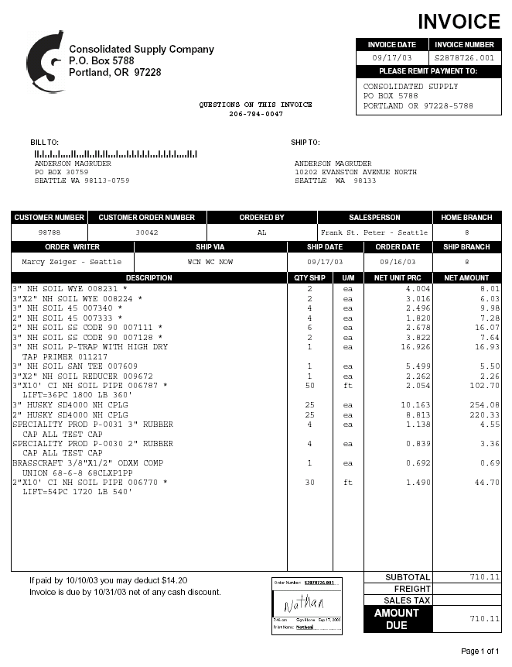
Advanced Fax Billing
One fax per day for each customer
Customer names, fax number, and notes automatically sent with your billing files.
Schedule delivery during the day or night
Exact replicas of each invoice and statement included
Terms and conditions can be faxed as the last page

Slide 21
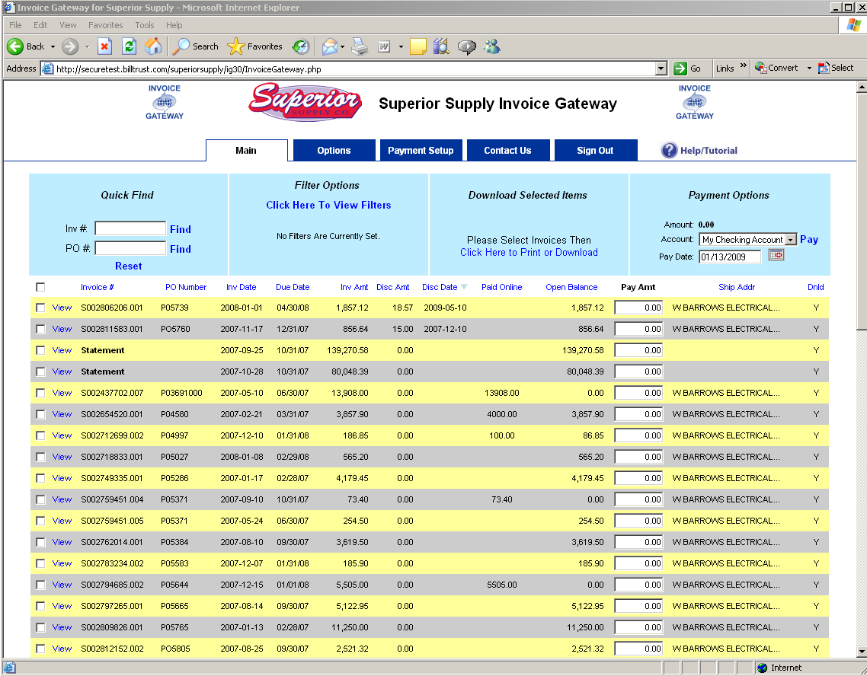
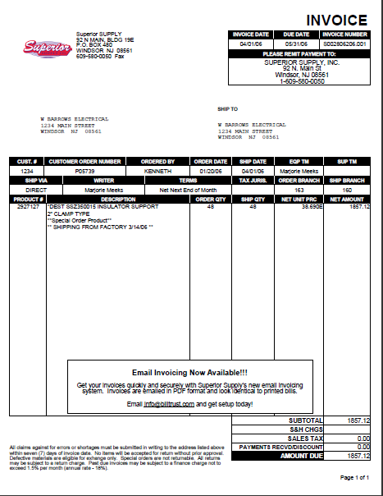
Invoice Gateway: Web Access for Customers
Quickly find individual invoices
Electronic payments via ACH or credit card
Easily view a PDF
copy of any bill

Slide 22
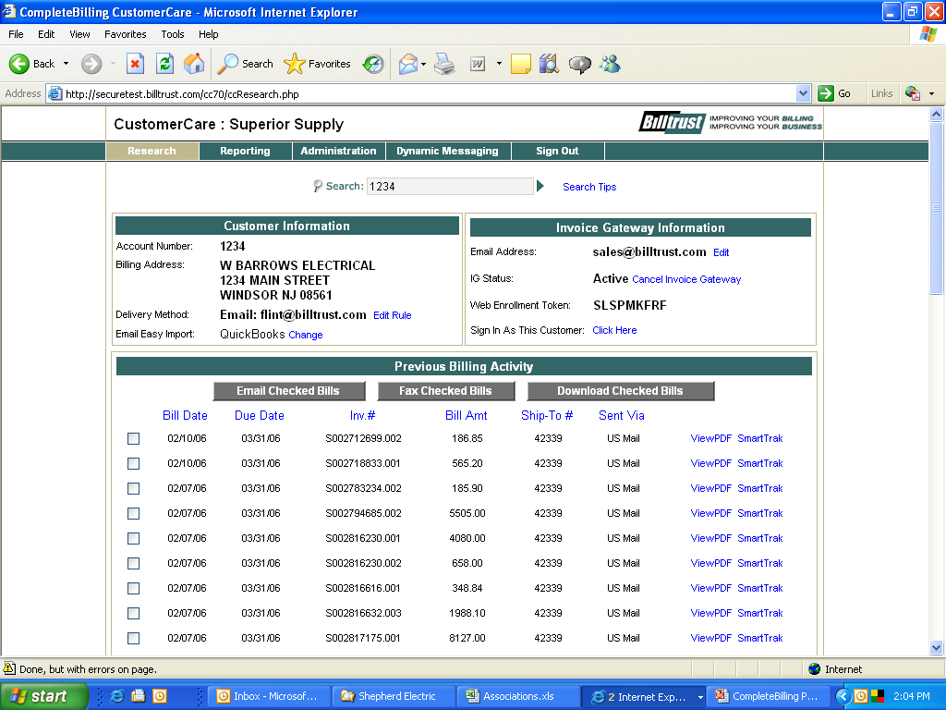
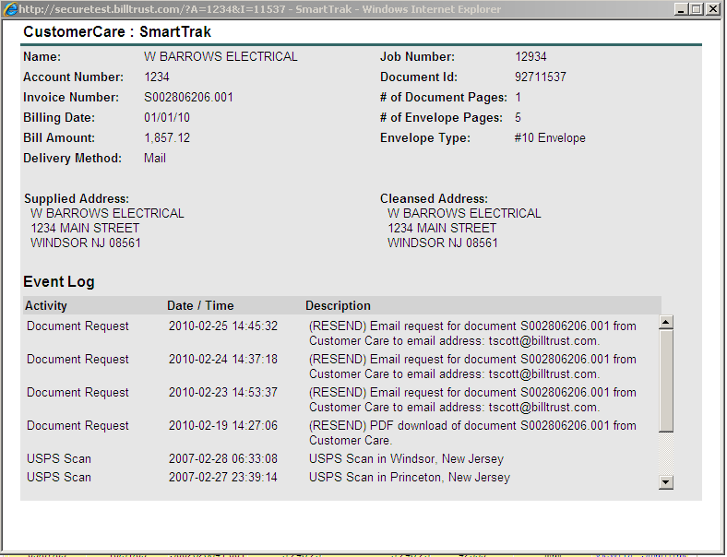
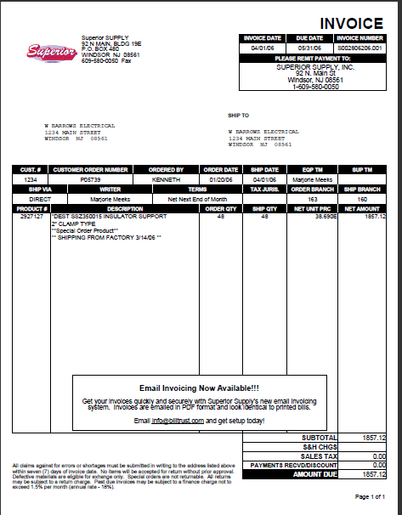
CustomerCare: Web Access for Credit Managers
Track invoices and statements from processing to delivery
Quickly Lookup Customers By Name, Account Number, PO Number, Invoice Number or Email
Integrated fax and email capability makes sending reprints a snap!
Easily view a PDF copy of any bill

Slide 23
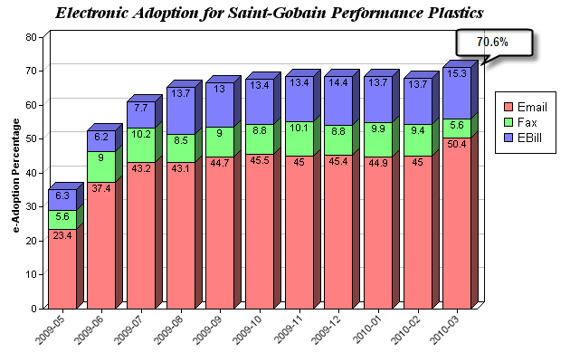
e-Adoption Marketing Works!
e-Adoption rate for Billtrust B2B clients averages 35% today, with many over 50%
Free program with 12 proven best practices
Product + Process + People

Slide 24
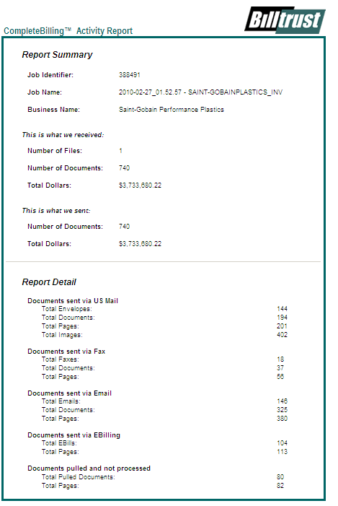
Sample Job Activity Report
  Daily email summarizes the billing job
  $ Amount billed and processed
  Delivery channels
  Pulls
24
Notes:
Explain Pulls
24

Slide 25
Saint Gobain – Case Study
Before Billtrust
Outsourced to a print and mail/EIPP provider.
  Wanted more cost savings, security, tracking, customer service and billing features.
Significant time spent responding to customer requests for resending documents and status of invoices and statements sent.
After Billtrust
Reduced costs over 50% versus previous provider
Offered a branded web site where customers could research, view, and download bills.
Offered advanced email and fax features that customers like such as EasyImport
Easy to resend invoices
Can track invoices to respond to customer inquires
Ability to market to customers with messages on the bill and with inserts.
Driving internal productivity –own divisions are using Invoice Gateway

Slide 26
Saint Gobain: Best Practices for QAD users
Take advantage of full billing suite – Paper, email, fax and online.
Take the opportunity to redesign the bill – use Billtrust's resources.
Modify customer master to define routing. Could have used CustomerCare.
Send 100% of invoices to Billtrust, even EDI. EDI bills are pulled and are accessible in CustomerCare and Invoice Gateway.
Daily files are sent back to Saint Gobain in PDF format for archiving.
All sites are consolidated - one billing file is sent.
Drive internal adoption.
Learn how to use tools – e.g. bill marketing.

Slide 27
Immediate Reward with Minimal Effort
20-35% savings from Paper Billing
Double those savings with more e-billing
Faster collections with online billing & payment
Sell more to existing customers
Low impact on your IT and Credit resources
Key Benefit: Lets You Focus on Your Business!

Slide 28
Billtrust – QAD’s Partner for Billing Services
"I love reporting my billing costs every month because they are going lower and lower! In the first four months after going live with Billtrust, our e-billing rate grew from 25 % to 65%."
Peggy Kemp, Manager of Credit and Collections, Saint-Gobain Performance Plastics, OH

