Slide 1
Culligan International
Dealer Portal and QAD Integration
Using QXtend

Slide 2
Agenda
Introductions
Business Background
QAD Applications Footprint
Business Case
Project Summary
QAD Functional Integration
Dealer Portal Design
QXtend Integration
Rollout and Results

Slide 3
Introductions
Paul Zarazinski
2005 – 2014 – CIO - Culligan International
1999 – 2005 – CIO - General Binding Corporation
1998 – 2000 – VP of IT - Kerry Americas
1995 – 1997 – Director of IT - The Mallinckrodt Group, Inc
Northern Illinois University
Based in Chicago IL

Slide 4
Introductions
Tim Lovely
1995 – Current – Principal – Logan Consulting
1993 – 1995– Account Representative - PPG Industries, Inc.
Worked with QAD v7.3 to 2013EE
Project Management, IT Strategy, Assessment, QAD Functional Work
Emory University
Based in Telluride CO

Slide 5
Introductions
Mike Montgomery
1996 – Present - President - liQuidprint, Inc.
1990 – 1996 – Product Manager - Odesta Systems
liQuidprint - Web Design and Development
University of Chicago
Based in Chicago IL

Slide 6
Introductions
Gary Yang
2010 – Present – President / Principal Consultant – Roundview Technologies (Logan Consulting Partner firm)
1997 – 2010 – Senior Technical Solutions Architect – RCM Technologies
1996 – 1997 – Programmer / Analyst - Optical Imaging System
Expert In Various Areas Of QAD Technology: QXtend, .Net UI / Desktop, CSS, Non-Intrusive Customizations, TrM, etc.
Implemented QXtend In First QAD Product (QPS)
Had First Successful QXtend Implementation (Excel Industries) Used Often As References
Spoke In Many User Group Meetings On QXtend, CSS and Desktop / .Net UI
University of Michigan and Shanghai Jiao Tong University
Based in Detroit MI

Slide 7
Business Background
Culligan International has offices in over 75 countries
750 Dealerships in the US alone
Products:
Household Water Softeners and Filters
RO Systems
Commercial Water Softeners and Filters
Water & POU Coolers
Water & Salt Delivery
Service
Retail Products
In-Store Bottle Water Dispensers

Slide 8
Business Background
Business model was similar to McDonalds – Company Owned Dealers and Franchises
Currently all are franchises with no Company Owned Dealers (COD’s)
Dealers sell direct to households, service and deliver product
Dealers purchase product from Culligan Corporate

Slide 9
QAD Applications Footprint
Prior to 2010 – Integrated QAD
Corporate – QAD 2007SE
Canada – QAD 2007SE
Retail – QAD 2007SE
COD’s - QAD 2007SE
Two Databases (Canada and US)
Current Model
COD’s were sold to individual franchisees running their own systems

Slide 10
C-PORT Business Case
Under new ownership, Culligan decided to implement a new business model
All company owned dealers (COD) in North America were sold to existing franchisees or new franchisees
Culligan reduced the number of locations from 75 to 3
The number of customers in the household business went from approximately 1.5 million to 750.
Customer Service and Information Technology refocused their efforts to support the 750 franchisees
The Culligan organization was perceived by its business partners as being difficult to interface with.
Recognizing that perception, the Culligan Portal (C-Port) project focused on the vision composed of 2 elements:
“Making Culligan easy to do business with”
Allowing a central location for all communication and interaction with dealers and customers.

Slide 11
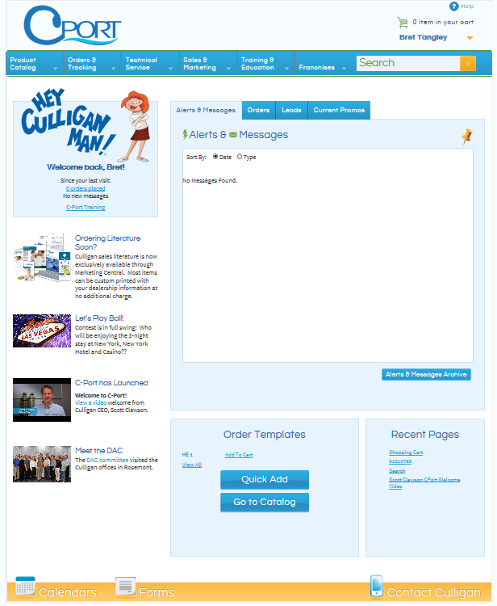
Project Summary
Culligan Dealer Portal (C-Port)
Replaces outdated myculligan.com
Focused on Culligan US and Canadian dealers (independently owned)
Logan Consulting
Managed functional and integration requirements between C-Port and QAD 2007SE
QXtend Integration – Gary Yang:
Item Catalog from QAD -> C-Port (file)
QAD List Pricing from QAD -> C-Port (file)
Real time order verification after item catalog / shopping cart
Real time ship-to integration to/from QAD
Real time order submit from C-Port -> QAD
LiquidPrint - Chicago based web development
Developed wireframes for C-Port
Handled all portal development and web parts

Slide 12
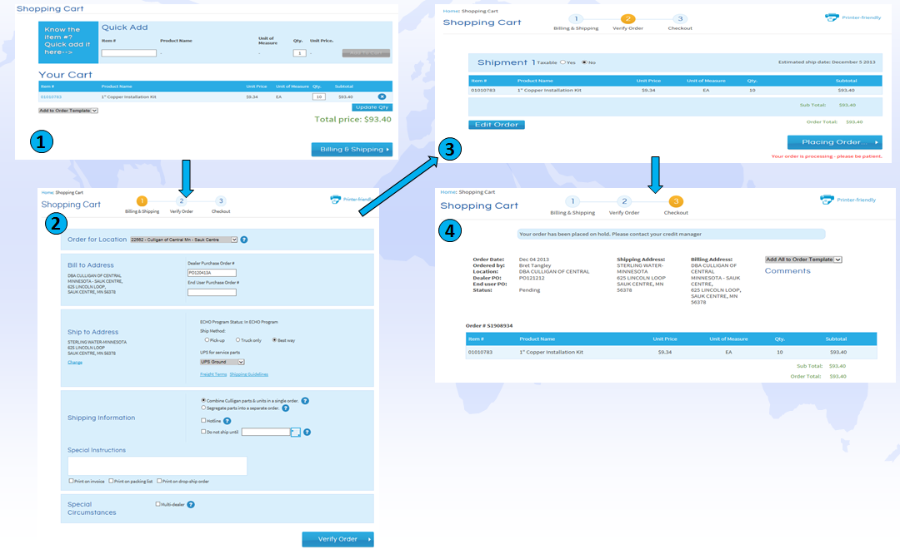
Project Summary
Item Catalog / Pricing – Quick Add / Shopping Cart
Billing & Shipping – Ship-to Information
Order Verify – Complex Culligan custom rules!
Order Submit – Order created in QAD

Slide 13
QAD Functional Integration
QAD Functional Challenges
Item Catalog and Item Pricing
Item List Pricing – based on various price lists, US and Canada
Price Break Pricing – used to display potential breaks for customer
Customer Ship-to
Create using standard and custom fields
Default Site, Shipvia and Freight Terms by Ship-to
Order Verify
From which sites should item be sourced?
Is the Customer Authorized to Buy the item (ATB)?
Complex Pricing (using standard QAD) – may differ from list in catalog due to discounts, price breaks, etc…
Split orders based on rules (credit terms by item, sourcing site, retail, stainless, EMT, multi-dealer, kit/non-kit, multi currency)
Order Submit
Standard Qxtend with response for Thankyou page!

Slide 14
Portal Challenges
Become the 1 stop shop for ALL franchise needs
Support complex business rules.
Make it easy for product gurus but don’t scare the newbies

Slide 15
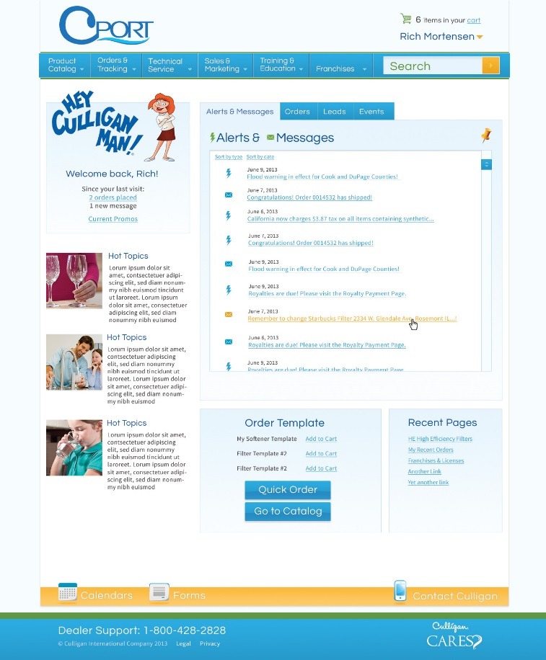
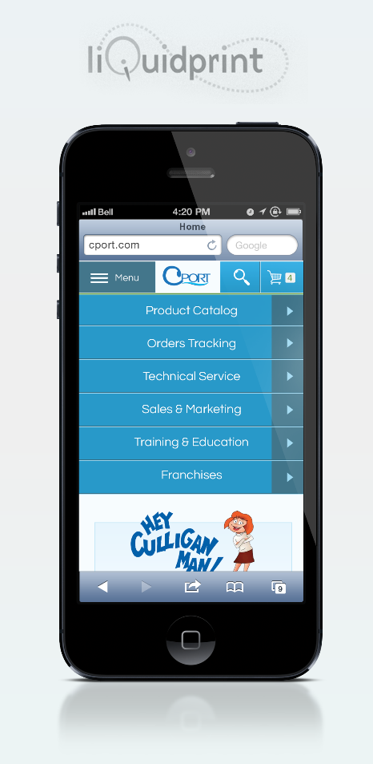
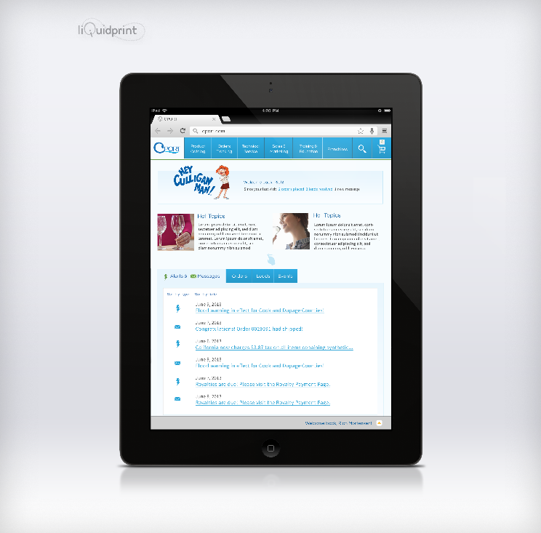
Design
Branded the Portal as Cport
Tied into Culligan Branding
Designed for multiple devices
Desktop
Smart Phones
Tablets

Slide 16
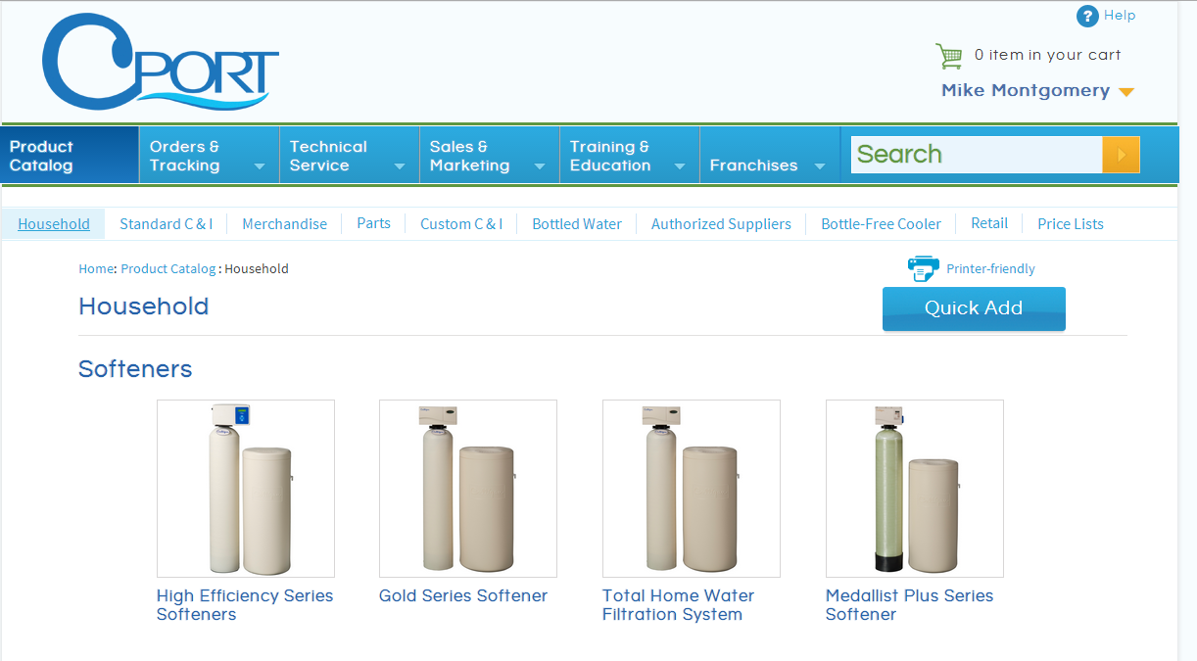
1 Stop Shop
Product Catalog
Diverse (not big) catalog
Includes systems, parts, drop ship items, etc.
Data load each night from QAD
Item file
Dealer file
Pricing file

Slide 17
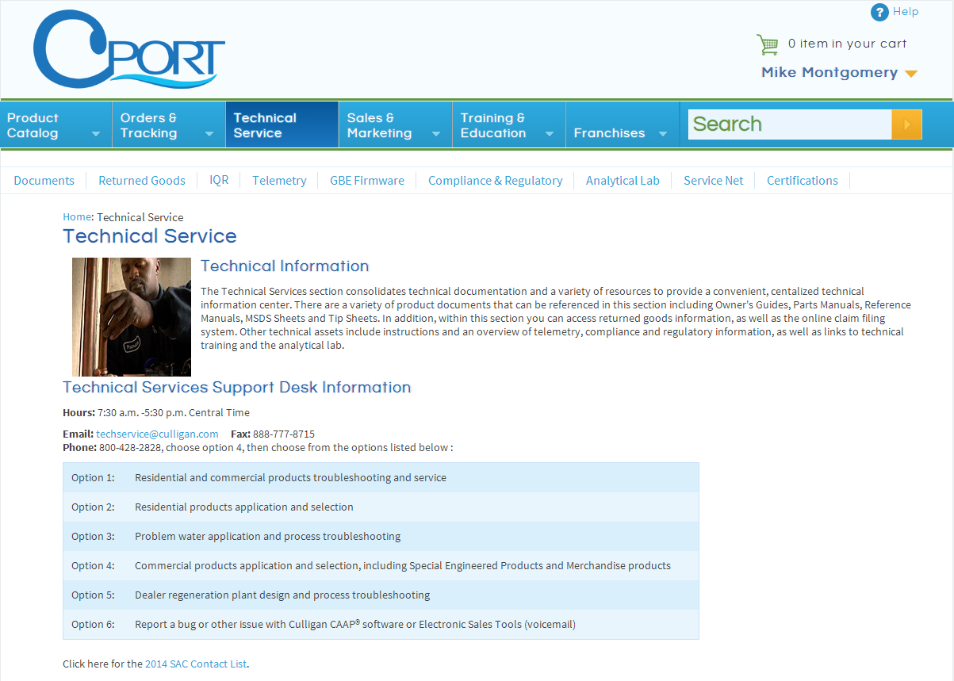
1 Stop Shop
Technical Service
Documents
Manuals (active & archive)
Tip Sheets
Tech Tips
MSDS
Field Tech apps
Other
Certifications
Resources

Slide 18
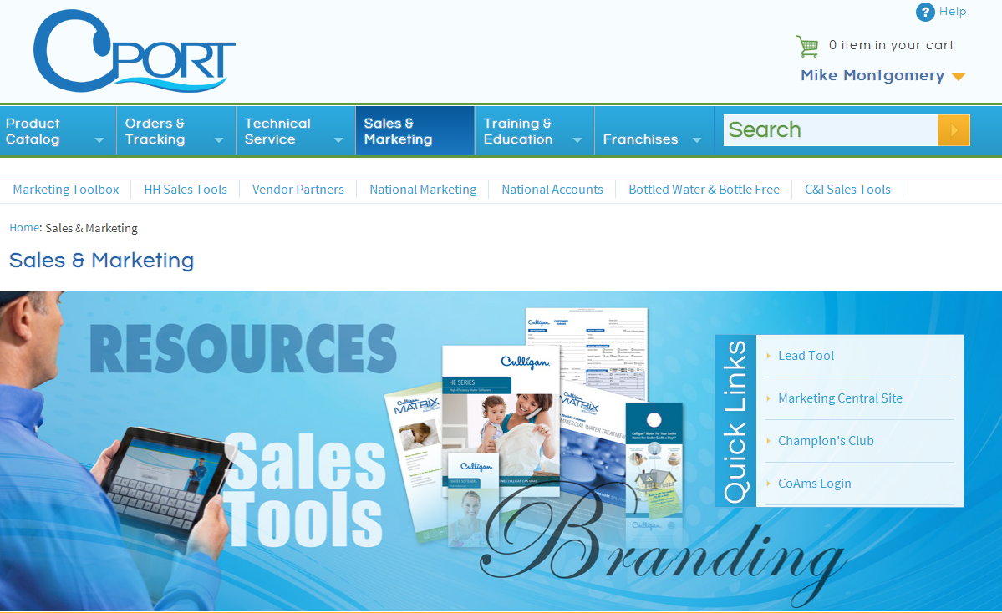
1 Stop Shop
Sales & Marketing
Literature
Tools
Partner Programs
SSO to 7 external platforms

Slide 19
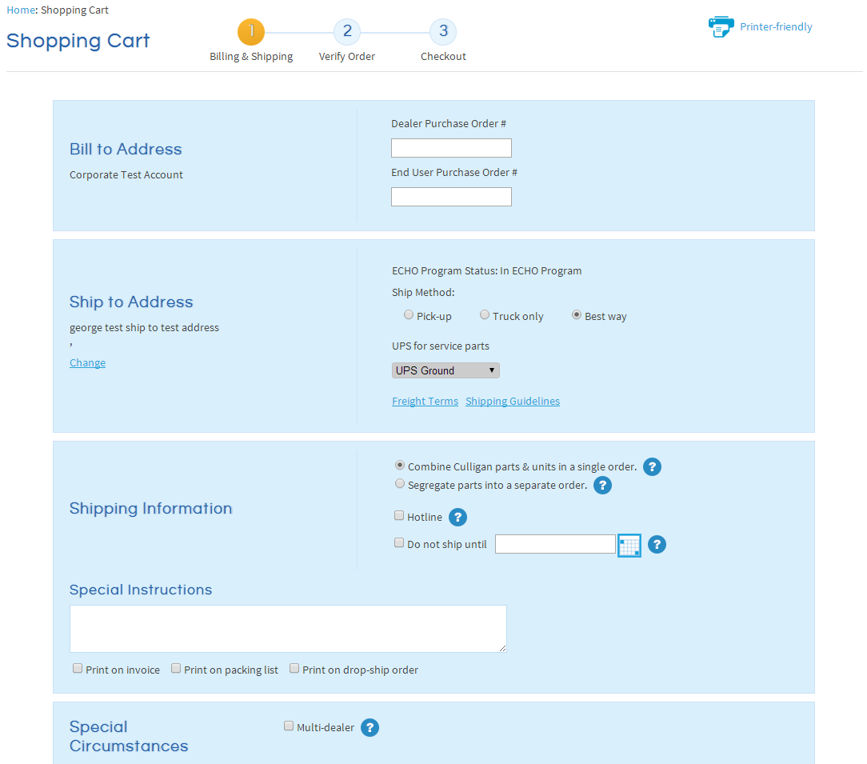
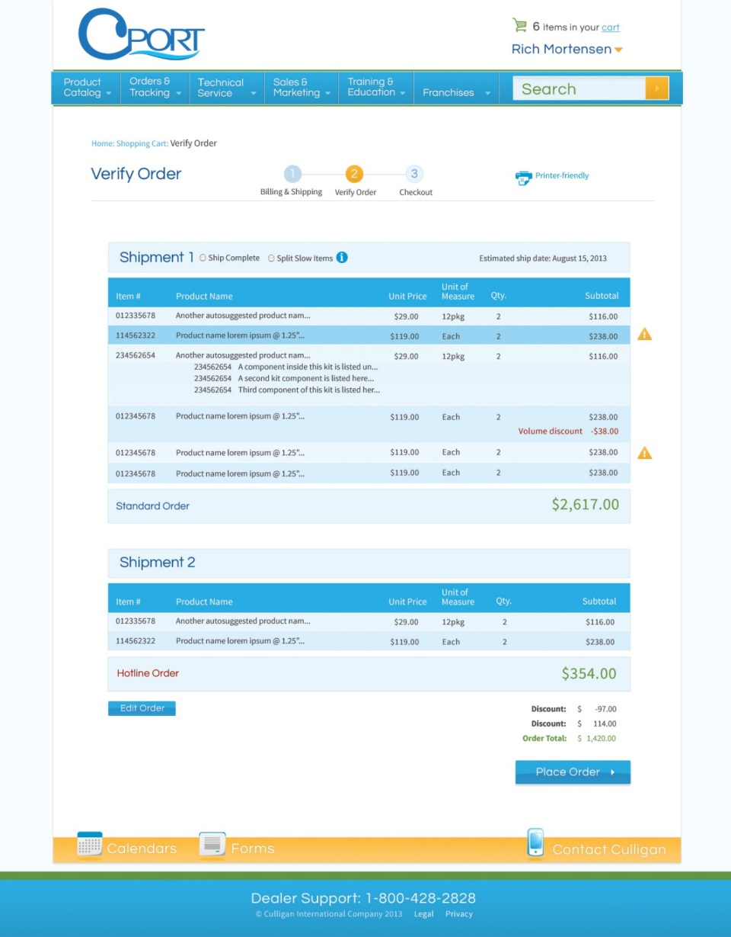
Ordering

Slide 20
QXtend Integration
QAD’s QXtend Product Was Chosen To Provide Integration Between C-Port and QAD Enterprise Application
Send Data From QAD To C-Port In XML Format (QXtend Outbound)
Provide Real Time Inquiry Of QAD Data For C-Port
Encapsulate Complex QAD Business Logic And Make Them Available To C-Port Via QXtend Inbound SI (Service Interface)
Allows C-Port To Submit Transactions To QAD In Real Time

Slide 21
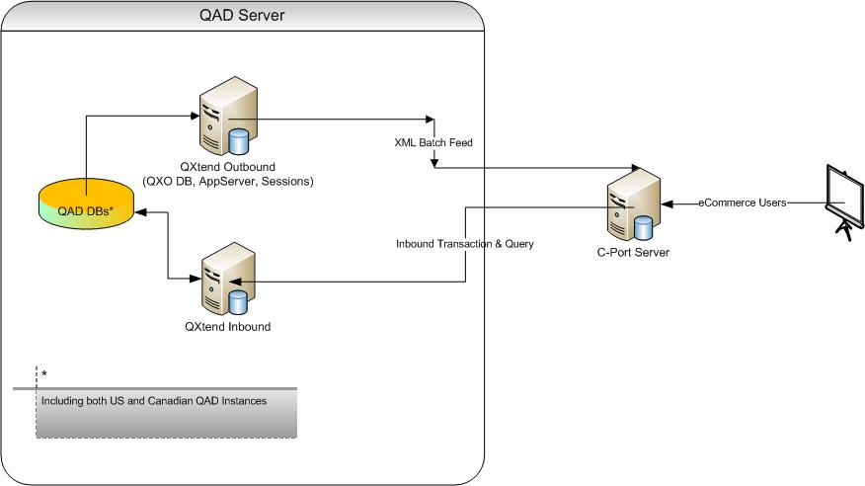
QXtend Integration

Slide 22
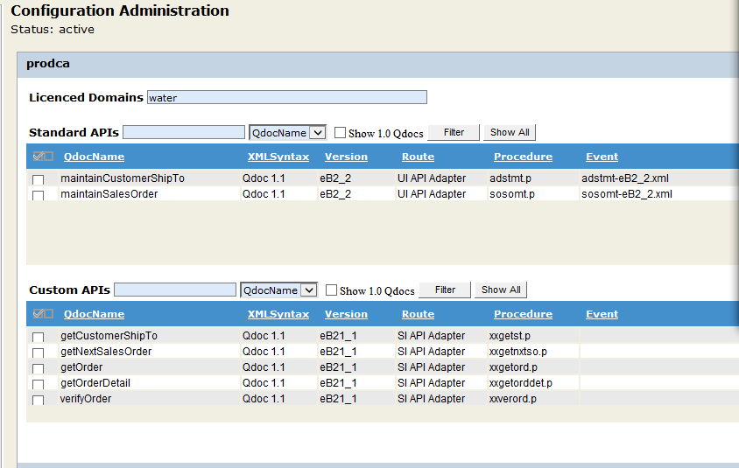
QXtend Integration

Slide 23
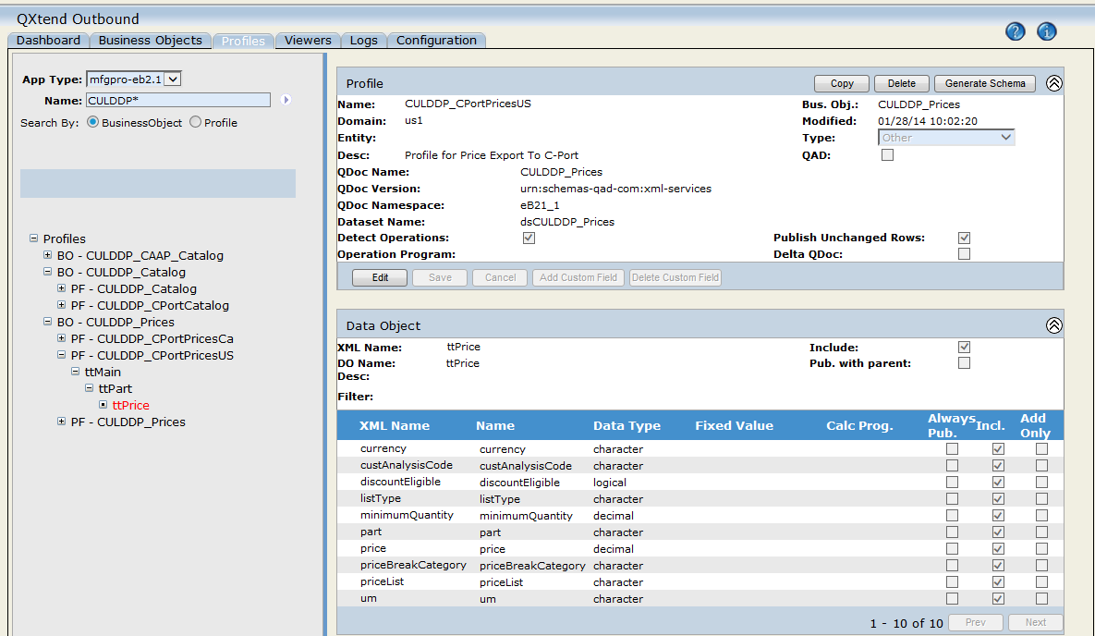
QXtend Integration

Slide 24
QXtend Integration
Functions For C-Port To Query Data In QAD
C-Port Calls QXtend SI Interface Web Service To Retrieve Data From QAD:
Order / Invoice History Header And Details
Customer can view the order / invoice history and drill down the details. This is accomplished via the C-Port calling QXtend SI interfaces which encapsulate the business logic and return the data fast
Ship To Addresses Of A Dealer (Customer)
This allows C-Port to retrieve the list of ship-to addressed for a dealer to choose via quick Web Service call
Order Verify
This is the most complex interface for the C-Port integration project at Culligan. C-Port calls this web service prior to let the user submit the order. This process executes various logic for order content validation, best pricing, order splitting, default value assignments (including channel codes, trailer codes, trailer amounts, hotline items, etc.), so C-Port can get the data ready for the creation of sales order.
Get Next Order Number
This SI QXtend interface is used by C-Port to get the next sales order number from Sales Order Control file prior to sending the order to QAD – the reason was that we do not want the sales order creation process to lock the sales order control file for the duration of the processing

Slide 25
QXtend Integration
Functions For C-Port To Post Transactional Data To QAD
QXtend provides a conduit for C-Port to send transactions to QAD via Web Service Calls:
Customer Ship-To Address Creation (For Drop Ship)
B2B customers can submit a drop ship address to QAD and then use the new ship-to code in the order creation
Sales Order Creation
This interfaces with the Sales Order Maintenance screen in QAD which was customized using custom tags.

Slide 26
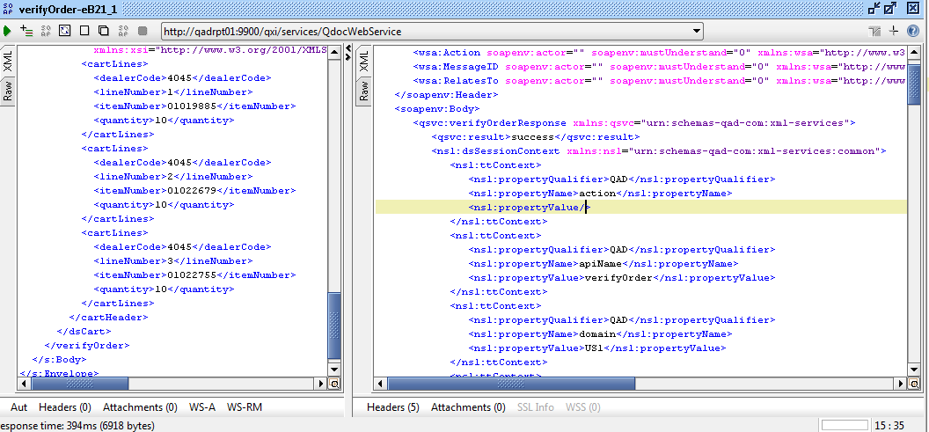
QXtend Integration
Sample Of the QDoc Processing

Slide 27
Rollout and Results
Mini Roll-out
8+ dealers
Seattle, WA
Dealer Road Show
10/30
11/5
11/6
12/10
12/3
11/7
12/2
11/6
12/6
11/5
Roll-out #2
316 US dealers
53 CN dealers
Rockford, IL
Albany, NY
Atlanta, GA
Dallas, TX
Baltimore, MD
Ft. Wayne, IN
Toronto, ON
12/4
Roll-out #1
245 dealers
Missoula, MT
Kansas City, MO
Denver, CO
Minneapolis, MN
Las Vegas, NV
12/4

Slide 28
Rollout and Results
Rollout included Dealer Road shows/Training sessions Late October/early November First Wave.
Second wave early December.
Canada in January.
The portal has been very well received.
As of Mid January 53% of orders were flowing through the portal.
An actual Email:
Hi Karen,
Just wanted to let you know C-PORT rocks!! This is so much easier to order, etc.. I have not needed to call tech support since the introduction/training on C-PORT.
Rex Munroe
Owner
Culligan Of Chico

Slide 29
Questions

