Slide 1
QAD Business Process Management
March, 2013
Chuck Macke
Notes:
Introductions

Slide 2
Who is Ralcorp Frozen?
A Leader in Private Brand Frozen Bakery Products
Channels
Food Service
Retail
In-Store Bakery
Products
Cookies (#1)
Pancake / Waffle (#1)
Refrigerated Dough (#1)
Bread / Biscuits
Notes:
We a leader in the provision of private label, frozen bakery products. Private label sometimes known as “store brands”, e.g., Great Value at WalMart, etc.
Channels
We are now a division of ConAgra, having been acquired in January
In food service, we supply both distributors like Sysco and US Foods and National QSVs like McDonald’s and Jack In The Box
We supply all of the major retailers like Walmart, Safeway, Kroger
ISB is largely retail, but another part of the store, where products are “baked” daily
Products
We maintain a leadership role in several private-label categories including cookies, waffles (supply most of McDonalds), and RD. We also supply most of McDonald’s biscuits. Much of our bread is of “artisan” quality.

Slide 3
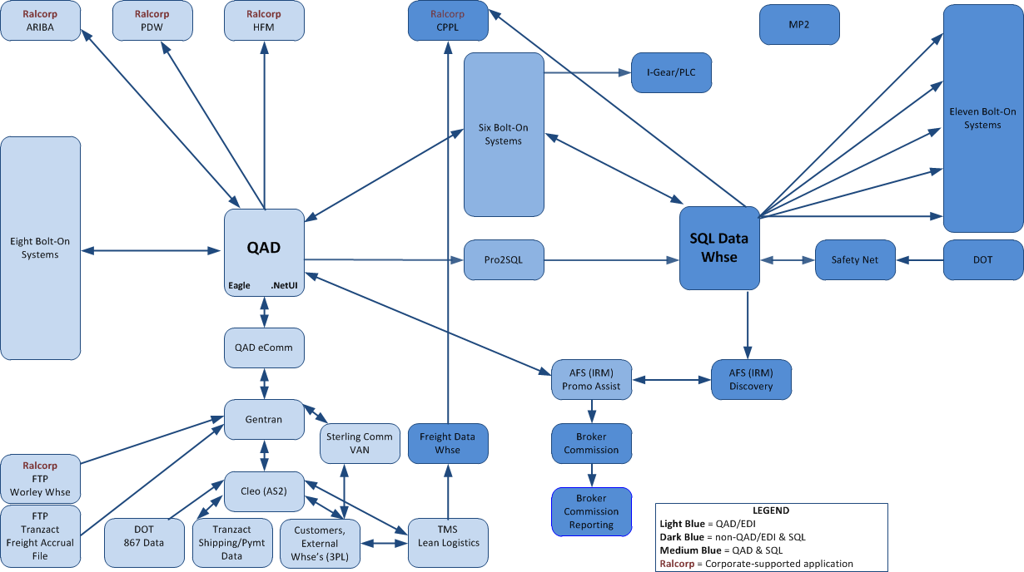
Ralcorp Frozen QAD Environment
Notes:
This is our application topography
Explain the following:
QAD is our ERP for all Financial, Order-to-Cash, Plan-to-Build, Procure-to-Pay processes
We’re on SE 2.1 2007, running .Net
We push data from Progress into SQL using Bravepoint’s Pro2SQL
Our SQL environment is our primary source of data for DW and interfaces with external systems
We interface directly with several RAH business intelligence tools like Hyperion Financials
The red circle describes a bolt-on system which represents our pre-BPM experience with workflow

Slide 4
Previous Workflow Experience
Trouble with master data
How to “herd the cats?”
Enter Data Source One (DS1)
Notes:
Trouble with master data
When QAD was originally implemented, Ralcorp experienced many issues taking, pricing, shipping, and reporting on customer orders
These issues were eventually traced back to incorrect or inadequate item master data setup
The real issue was that there was no systematic coordination to ensure the following existed prior to doing business with a product:
Marketing attributes
Bills of material
Routing
Costing
Pricing
Moreover, these activities are performed by 40 different people in different functional areas (mktg, QA, Finance, etc.). In native QAD, they may be using the same screens to enter different data elements, so it is difficult to assign accountability for clean, correct data.
How to “herd the cats?”
At the time we encountered this difficulty, there was no QAD-based workflow solution, and no tools like MS Sharepoint
It was decided to build a standalone application to mimic the data capture capabilities of QAD
Enter DS1 – an advantage over native QAD for the following reasons:
We could logically apportion the data-capture by function
We could control the flow between functions, e.g., to ensure costing follows BOM and router definition
We could prompt each function to do their part through email triggers
We could “see” the status of the setup – who has “done their part”, and “who has the ball”
We could ensure that no item was added to QAD until all of its requisite data had been entered properly
How did we do this?
We built our own software using VB .Net and SQL!
We trained everyone to do their “item creation” activities in DS1
We CIM-load the completed item masters daily as they are completed, ensuring complete editing

Slide 5
Previous Workflow Experience
Notes:
Note the screen shot – the item maintenance is tabbed logically by RFBP function
Each tab shows only the data required for that function
“Promotion” to next function handled by green button
Change Log shows who did what when

Slide 6
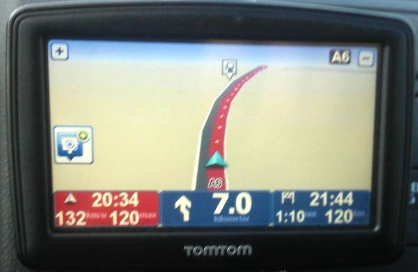
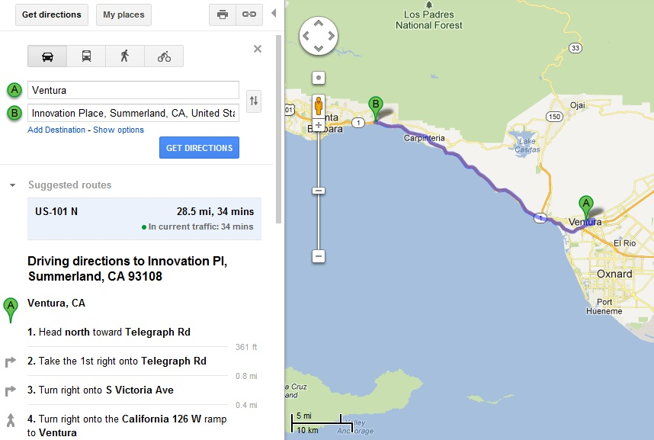
Maps to Navigation
QAD Business Process Management (BPM)
Notes:
So then BPM came along, and we decided to become an “early adopter”. But first, what is BPM?
The following slides on BPM were borrowed from Richard Day, Program Manager for BPM at QAD
I am sure you are familiar with the way we get driving directions has changed over the past 10 or 15 years.
If we go back 10-15 years we were very reliant on paper based maps and part of getting from A to B involved pulling out the maps and determining the best route. This was time consuming and there was no guarantee you would get the best route, also as time went on the maps would get out of date.
[c] If we move on a few years a number of websites started to provide the ability to enter your starting and ending points and they would generate a list of directions that you could follow to get from A to B. This was great but you still had to read the instructions, which could prove to be difficult whilst driving on unfamiliar roads and it was very easy to miss a turn and get lost.
[c] Looking at the options we have today with either a SAT NAV or Mobile device, we can get the device to calculate the best route and then give us step by step instructions as you need them. The system tells you when to turn left, turn right and when you have arrived. It guides you from the beginning of the journey to the end.
This is a great analogy for migration from menu driven to process driven systems.

Slide 7
Menu Driven Systems
QAD Business Process Management (BPM)
Processes hidden
No active monitoring
Difficult to manage
No task ownership
Difficult to adapt
Unaware of status
Notes:
I would like to talk for a minute about traditional menu driven applications.
The application user is presented with a entire menu system with 100’s or 1000’s of menu options used to interact with the system and process transactions. There is no link to a process and the interaction requires the user to know where in the application that they need to go to perform a specific task.
The processes are implied in the system and requires another source of knowledge or information to know what tasks must be performed. If you take the example of creating an Item, you have to setup the Item before the Bill Of Material and the Routing, this is an implied process flow.
As the processes are not explicitly implemented in the system it is very difficult to actively monitor a process. How do we know where in the process the process an item is, it may have been setup and be waiting for the BOM to be entered but there is not easy way to determine the current status.
There is no concept of task ownership implemented in the menu system, all we can do is restrict access to menu functions.
With menu based systems it is hard to measure how effective the processes in the system are as the information is simply not available. They are also hard to adapt as the way a process is executed is documented and controlled by humans rather than the system.

Slide 8
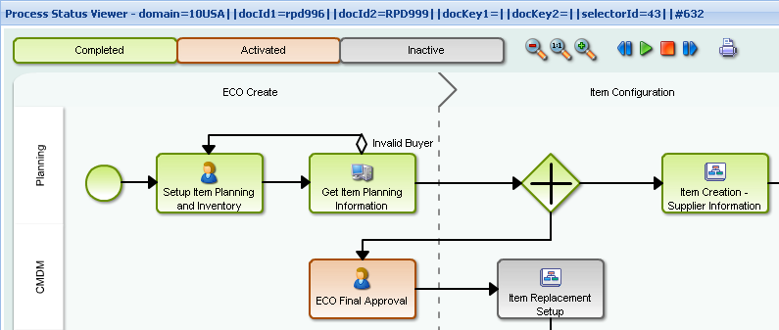
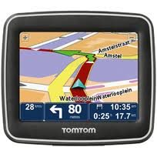
Process Driven Systems
QAD Business Process Management (BPM)
BPMS Application
Visualize your processes
Control & automate
Collect metrics
Improve process agility
Facilitate optimization
Traditional Application
Notes:
If we look at a process driven system, we start to see the process becoming an integral part of the system users interact with during their daily tasks.
The process is explicitly documented and the tasks are assigned to specific users/group of users. The process can be easily visualized at any stage and the process status is clearly shown using a standards based graphical representation.
The execution of the process is controlled by the BPM system, the process can include process logic that decides on the flow and takes responsibility for assigning tasks to the correct user/group.
The start and end time of each process and task is recorded, this provides new information about the process and can be analzyed to get a good understanding of how efficient the process is.
The processes can be easily changed to meet the needs of the business by changing the model, when the changes are deployed the system automatically executes the process according to the new model. This makes the process very agile and allows changes to be made quickly and efficiently.
The processes and the BPM system provide real time guidance to the users of the system and act like a bit like a SAT NAV.

Slide 9
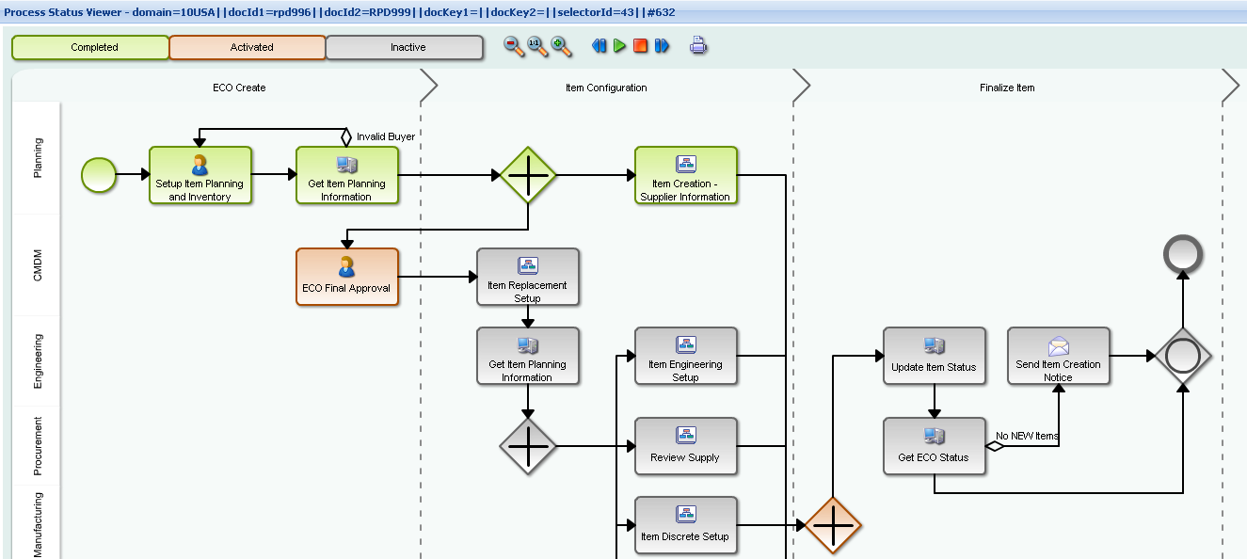
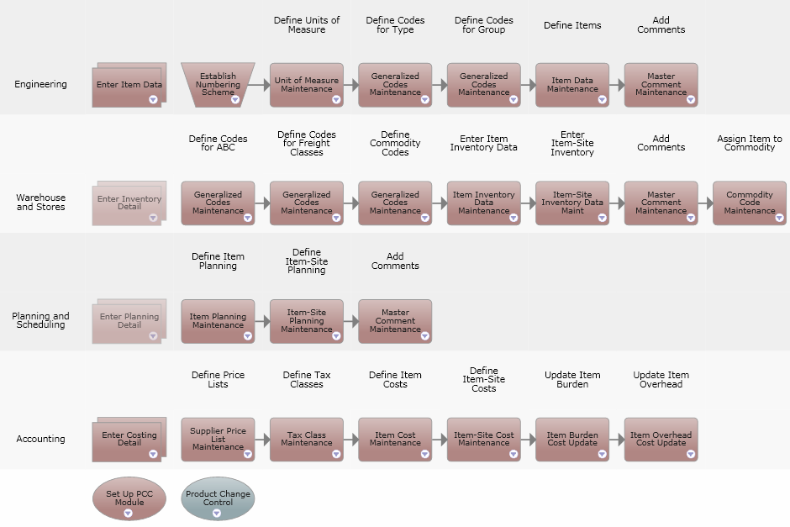
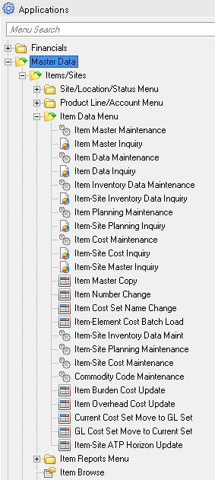
Select Menus to Explicit Processes
QAD Business Process Management (BPM)
Notes:
You can draw many parallels between the migration from menu based systems to process and role based systems and the evolution of Maps to SAT NAV.
The menus are essentially your book of maps, they have all of the options needed to get from A to B but you have to decide and document how to use them.
[c] The introduction of Process Maps can be compared to the generation of driving instructions, they document how the system should be used and the steps you need to take to get from A to B but they do not tell you when a certain task needs to be done and they do not guide you through the execution of a process.
[c] BPM becomes the satellite navigation system on key business processes and provides the users with step by step instructions on what needs to be done and more importantly when it needs to be done. Much like a Sat Nav will tell drivers when to turn, BPM will tell the right people when to setup the Bill Of Materials and will create alerts when deadlines are missed. BPM like Sat Nav also provides a map that shows the current progress and how much is remaining.
It is not required to convert an entire application to be process driven, menu and process driven approaches can happily co-exist. This allows focus to be given to the areas of the system that will yield the most benefit from being process oriented. Processes implied in the QAD menu structure and process maps can be explicitly defined and used to guide users through the execution of day to day process related tasks.
BPM does not address all of the longer term usability requirements of an enterprise application but it does play a key role. Future release of QAD Enterprise Applications will use a combination of Role-Based Centers, Business Intelligence & BPM to provide a role based, user centric process oriented view of the QAD Enterprise Application suite.

Slide 10
What is Business Process Management ?
QAD Business Process Management (BPM)
The discipline of building, measuring and improving the efficiency and effectiveness of business processes within an Enterprise
Foundation:
Visualization
Automation
Control
Advanced:
Measurement
Continuous Improvement
Notes:
So, what is BPM and how does it help with the challenges of achieving the vision of the effective enterprise ?
BPM is a discipline allowing an enterprise to build, measure and continually improve the efficiency and effectiveness of its business processes.
The primary features of BPM address the process challenges of the effective enterprise and can be split into two areas.
[c] Foundation. The foundation components provide the building blocks for BPM. The tools are used to address the Visualization and Control challenges of the effective enterprise, add to this the ability to automate parts of processes and it provides a satellite navigation system for business processes.
Considerable benefit is realized just by focusing on the foundational aspects of BPM.
[c] Advanced BPM capabilities build on the strong foundations and enable the process effectiveness to be measured, analyzed and improved.

Slide 11
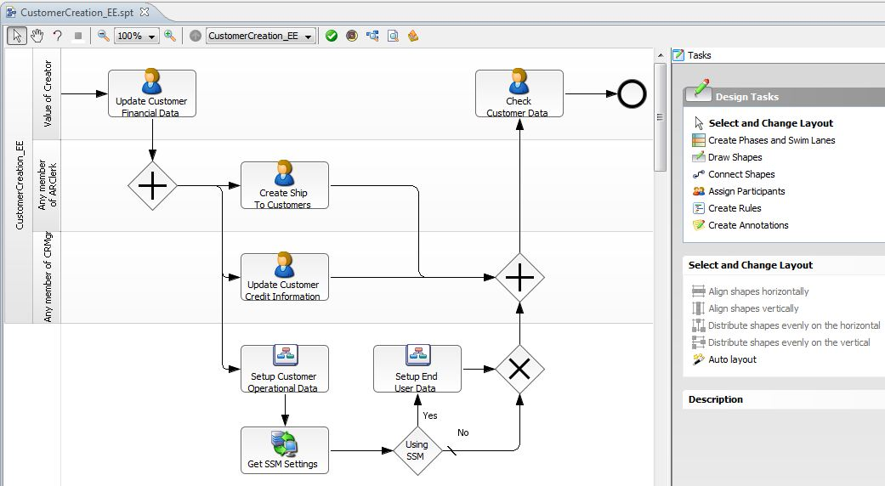
Visualization—Process Modelling
QAD Business Process Management (BPM)
Define task ownership
Link to QAD screens
Set priority & duration
Include instructions
Notes:
The Visualization of a business process begins with process modelling.
[c] The process model defines the tasks that make up the process, people responsible and the screen that is used to perform it.
[c] The task ownership can be by individual user or a role. While building the process the expected duration of each task is defined, this is used to calculate the due date of a task when it is created and special actions can be triggered when a task is late.
[c] It is also possible to include specific work instructions for each human task, these instructions can be accessed by the assigned user to provide guidance on the action that need to be performed. This is particularly useful if the task is not part of the day to day routine.
Just like a SAT NAV this provides the route you need to follow through the business process.

Slide 12
Why QAD BPM?
Replace DS1
Avoid DS1 upgrade & ongoing maintenance
Still need to know who’s got the ball
With BPM we gain concurrency
QAD is single source of the truth
Apply to other processes without (much) programming
Lean Culture
Process is everything!
Need metrics to support problem-solving
Notes:
So what were Ralcorp’s motivations for pursuing BPM?
Replace DS1
As I like to say, had BPM existed in 2010, we would not have built DS1
DS1 must be kept in-synch with QAD and by definition, must duplicate much edit logic. DUPLICATION IS MUDA!
We faced an upgrade of DS1 in 2012 at same time the BPM Early Adopter program started, so we decided to take the plunge
BPM inherently lets us know who’s got the ball, because the workflow maps QAD screens into a process map, with individual roles assigned to each screen.
DS1 was not built for concurrency, but BPM allows you to make process flows concurrent, much like the swim lanes of a flow diagram. So, the engineers can be setting up the BOMs while the marketeers are defining the attributes.
We used the built-in capabilities of .Net to create versions of the QAD screens which are tailored to each role – containing only the necessary data fields for simplicity and accountability sake.
With BPM, all of our master data is now in one place, so we have a single source of the truth
We will eventually apply BPM to our customer and supplier processes, as well as other processes where process efficiency is of the essence
Lean Culture
Ralcorp Frozen is a private label food manufacturer, which means we create less-expensive versions of branded products. We also pride ourselves on being able to quickly tailor specialized product formulas for our customers
The only way to be less expensive AND custom is to have excellent process
Hence Frozen has a heavy emphasis on Lean culture – with CI and A3 problem-solving being skill expectations of every employee
It is imperative that our process problem-solving be fact-based and data-driven – without BPM, analysis is very manual and time-consuming

Slide 13
Why QAD BPM?
Notes:
This is an example of what we have produced manually using data from DS1
We hope to automate the production of data to support charts like this from BPM
Explain the Pareto Chart and the fact that it has two scales – the left scale is for the bars, and the right is for the red line
This chart shows the reason for product setup delays in our ISB business during a portion of 2012 (click five times)
Read some of the reasons and explain the 80-20 (click the last time to show the five reasons exceed 80% of the problem)

Slide 14
Ralcorp BPM Timeline
End Date | Activity
9/15/12 | Early Adopter Agreement
10/1 | Upgrade Progress, .Net, Java
10/31 | Install QExtend
10/31 | Complete Configured Screens
11/21 | Complete BPM Workshop
Dec/Jan | (Mostly) Hiatus
Feb | Practice Installs, Documentation, Training
3/11 | Go-Live – ISB Finished Goods
TBD | Go-Lives – All Finished Goods, Raw, WIP
Notes:
All are completion dates
October was largely the installation of the software and development of configured screens
November was largely the workshop QAD conducted for the better part of 3 weeks
Dec/Jan was hiatus due to higher-priority projects and QAD performance issues, largely of our own making
Feb has been a LOT of work on practice installs, plus documentation and training of the first wave of users. To control risk, we are implementing finished goods only for one of our channels, which minimizes the number of people and locations. We’ll roll out to the rest of the channels and items in a yet-to-be-scheduled phase.

Slide 15
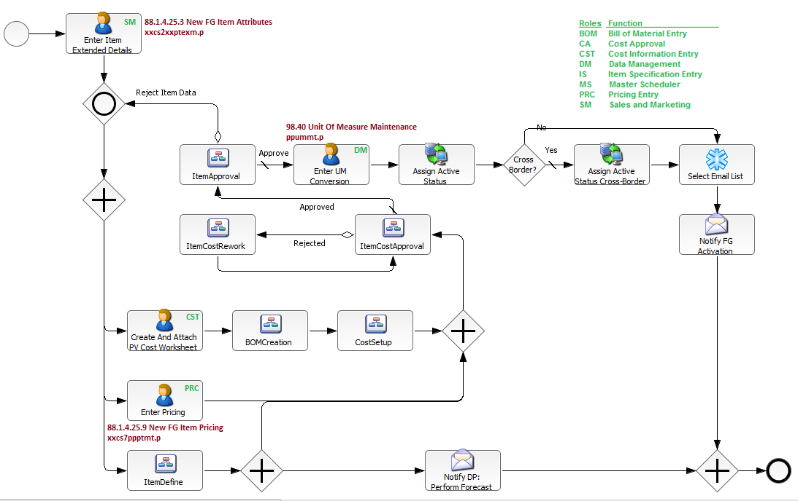
Item Maintenance Under BPM
Notes:
This is a screen image from the BPM workflow designer, showing a portion of our re-designed new product flow
(we took the opportunity to add parallelism to the process and remove unneeded steps)
Note the following features:
BPM allows for processes to be completed in parallel, reducing overall calendar time.
The icons with a person link directly to a role and a QAD screen (click to show 1st circle, and point out other examples)
The icons with a flowchart icon are actually drilldowns to other flows. This makes it easy to assemble fairly complex flows and re-use flows as necessary. (Click to show 2nd circle)
The plus signs indicate that all of the connected branches must be performed. For example, we perform the costing, pricing, and initial item definition steps in parallel. (Click to show 3rd circle)
The slash indicates the default branch from a decision (click to show)
The icon with the monitor and database and arrows is a QExtend call to update the database as the result of a workflow action. All database updates which happen outside of QAD transaction logic are handled via Qextend, which requires some Java programming. (click to show)
The snowflake is a decision table. This adds intelligence to the workflow by allowing you to define logic which is dependent on the actions taken in a workflow. In this case, we interrogate the sales channel of the new item in order to determine who should be notified of the item’s creation. (click to show)
The envelope icons are email notifications. (click to show)
Green labels indicate who performs the task.
Review list of roles on diagram, and then walk the process using pointer to describe what happens.

Slide 16
Item Maintenance Under BPM
Notes:
This is the same process flow from the point of view of the project manager for the new product.
With BPM, she can pull up a graphical status of the process flow for any new product and see:
What has been completed (click - green)
Who has the ball (click - red)
What has not yet happened (click - gray)
This makes it easy to determine WHICH of the 40 people needs a little follow-up nudge when things are delayed
And of course, timings are saved so we can do process analysis later.

Slide 17
Item Maintenance Under BPM
Notes:
This is a tasklist view which is available to participants in the process. The idea is that participants access this browse each day to “work their list”. Click to show the circle around the tasklist.
Document ID1 = item#, Document ID2=Channel, Document Key 1=Item Group, Document Key2 = site. These are key fields which are set when coding the workflow, and contain user data.
Be sure to point out that you must mark your task complete so the system knows you’re “done”. The system cannot determine from the data whether any process step has been completed correctly – this still requires a human decision.

Slide 18
Anticipated Benefits
Now
Process owners know “who’s got the ball”
Data mining to support problem-solving
Process participant work list
Retire the DS1 system!
In summary, faster to market!
Future
“Heat Maps”
User-friendly metrics
Notes:
Now
Product managers used to call IT in order to determine the status of a new product setup. Now they will be able to go to a screen to see a graphical status of the flow.
BPM collects timing information on the completion of tasks which can be mined to support continuous improvement activities. The process flows can be built with documented target lead times for each task; these can be compared to actuals to support process analysis.
It’s easy for process participants to keep track of their assignments using the task list. They can delegate assignments as necessary as well, and these will be visible to the process manager.
Retirement of the Data Source 1 system will lighten the maintenance workload on the IT department.
Any company’s overall purpose is to make profits. For Ralcorp Frozen, every process improvement which adds speed–to-market will enable us to sell more of our food solutions.
Future
We’re excited by the prospect of “heat maps” which are generated from BPM. This will allow product managers to see visually where process bottlenecks exist over a period of time and will speed root-cause analysis
We’d like to see a data-mining facility which allows the BPM data to be mined by non-IT folks in support of their CI activities.

Slide 19
Lessons Learned
QExtend expertise needed
Java programming
Training
Metrics
Standard work, prototype, and continually improve
Notes:
Often – since we’re an early adopter — QAD solved the problems for us, rather than teaching us how to do it. We need to get self-sufficient
We are a small shop – eleven people – so QExtend is a very sophisticated tool. As such, we have needed a lot of help to install it properly and develop methods for migration to production.
Java
First, the basic modeling relatively straightforward and easy to use/modify
Any database updating/interrogating requires Qextend and therefore, Java programming. Decision tables are similar in complexity required.
Notification process fairly complex (a page of process steps), as compared to Sharepoint for same thing
Bottom line – need Qextend/Java expertise in-house or prepare to pay. Took a QExtend expert 2 days to code a cross-domain update.
We will definitely require QExtend training in order to properly administer the system on a daily basis, and extend its use beyond BPM. It has great capabilities for acting as a middleware wrapper around QAD, and we intend to leverage those in the future.
QAD has focused on getting the process modeling capabilities in place, and so we anxiously await some of the future metrics generation capabilities which QAD has yet to release. That said, the data is in the database, so we’ll mine it and leverage it in the meantime.
It is important to create a leaned-out process first (Standard Work), then prototype it (perhaps without BPM), capture the learnings, improve the process, then automate thru BPM. This creates the cycle of CI

Slide 20
Questions?

