Slide 1
Quality Management in Food & Beverage
QAD Midwest User Group
Steve Dombroski – Sr. Manager Industry Solutions, QAD
Bob Herdoiza – President of CEBOS

Slide 2
Safe Harbor Statement
QAD Midwest User Group
The following is intended to outline QAD’s general product direction. It is intended for information purposes only, and may not be incorporated into any contract. It is not a commitment to deliver any material, code, functional capabilities, and should not be relied upon in making purchasing decisions. The development, release, and timing of any features or functional capabilities described for QAD’s products remains at the sole discretion of QAD.

Slide 3
Agenda
QAD Midwest User Group
Why quality management is important
Major Food & Beverage regulations
QAD core tools to solve quality issues
CEBOS quality management system
Summary and next steps

Slide 4
Why Quality Management is Important
QAD Midwest User Group
To meet government regulations and standards
The most successful companies produce quality products
Recalls can be devastating
Quality management tools improve overall performance and reduces costs
Inspection procedures
Inventory control
Assists in preventing incidents

Slide 5
Relevant Regulations for Food & Beverage
QAD Midwest User Group
The Food Safety Modernization Act (FSMA)
The Safe Quality Food (SQF) Program
Hazard Analysis Critical Control Point (HACCP)
International Organization for Standardization (ISO)

Slide 6
The Food Safety Modernization Act (FSMA)
QAD Midwest User Group
What is it?
Set of laws governing food safety laws in the U.S.
Signed into law January 2011
Who enforces it?
United States Food and Drug Administration
Why?
Existing U.S. food laws outdated
New regulatory provisions

Slide 7
The Food Safety Modernization Act (FSMA)
QAD Midwest User Group
Major areas covered
Prevention of safety hazards
Detection of the response to safety problems
Improving the safety of imported products
Miscellaneous provisions
Major benefits
Gives the FDA new powers
FDA can now order recalls
Authorize stricter documentation and procedures
FDA now in prevention mode

Slide 8
The Food Safety Modernization Act (FSMA)
QAD Midwest User Group
Inspection and compliance
Mandated inspection frequency
All high risk facilities inspected within 5 years of the enactment of the law then every 3 years
FDA has the right to inspect foreign facilities
FDA will have access to all records
Safety plans
Procedures
Testing by accredited laboratories
FDA can request food to be inspected by offsite, independent testing facilities
FDA has authority to recall food
FDA has access to all food grower records
Farms that sell more than $500K need traceability
FDA can suspend registrations without notice

Slide 9
The Safe Quality Food (SQF) Program
QAD Midwest User Group
What is it?
Set of requirements to control and minimize safety standards
Provides certification recognized worldwide
Who manages it?
Global Food Safety Initiative (GFSI)
Safe Quality Food Institute (SQFI)
Why?
Provide food suppliers with certification
Provide proof of a rigorous safety program

Slide 10
The Safe Quality Food (SQF) Program
QAD Midwest User Group
How to attain certification
Demonstrate management commitment
Document control and records
Product safety fundamentals
Product safety plans
Verification and validation
Product identification and traceability
Site security
Allergen management and training

Slide 11
Hazard Analysis Critical Control Point (HACCP)
QAD Midwest User Group
What is it?
A preventative program to ensure safety
Who enforces it?
Food and Drug Administration (FDA)
Seafood and Juice
United States Department of Agriculture (USDA)
Meat and other foods
Why?
Currently voluntary
Standards for ensuring safety

Slide 12
Hazard Analysis Critical Control Point (HACCP)
QAD Midwest User Group
How to comply
Perform a hazard analysis
Identify critical control points
Document
Indentify and quantify critical limits
Develop monitoring requirements
Develop corrective action plans
Establish procedures
Establish and maintain record keeping procedures

Slide 13
International Organization for Standardization (ISO)
QAD Midwest User Group
Who are they?
International standard setting body
What do they do?
Produces standards
Technical reports
Technical specifications
Guidelines
Why?
Ensure product safety
Ensure all companies following same guidelines

Slide 14
ISO 22000
QAD Midwest User Group
International standard for F&B safety
A derivative of ISO 9000
Three major components
Total process documentation
Mandated employee training
Defined hazard levels

Slide 15
QAD Quality Management
QAD Midwest User Group

Slide 16
QAD Core Quality Management - Features
QAD Midwest User Group
Tracks supplier product quality
At incoming inspection
Testing during manufacturing
Inventory sampling
Trend reports by supplier or part
Certificate of Analysis generated for parts indicating:
Testing performed
Pass/fail statistics
Test instructions can be added to work order documentation
Test results and production progress reported easily
Stores the definitions of standard testing procedures

Slide 17
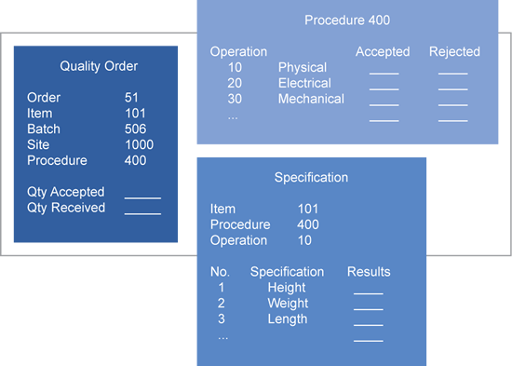
QAD Core Quality Management
QAD Midwest User Group
Sample quality inspection card
Includes all critical statistics

Slide 18
Lot Management
QAD Midwest User Group
Complete lot and serial number tracking
Finished products
Work in process
Raw materials – supplier tracing
Mandated by GMP’s
Support product liability
Warranty recalls
Investigation

Slide 19
Work in Process Lot Tracking
QAD Midwest User Group
Control combining and splitting of lots
Control the WIP inventory quantity-on-hand
Trace component material lots consumed
By routing
Finished lots
Trace by operation

Slide 20
QAD Core Quality Management - Value
QAD Midwest User Group
Ensures suppliers deliver quality parts
Improves the visibility of quality trends
Allows for addressing issues proactively
Allows suppliers to correct issues earlier
Provides visibility of quality issues
Streamlines inspection processes
Define certification of suppliers
Integrated to core operations
Real time data collection

Slide 21
CEBOS Quality Management System
QAD Midwest User Group

Slide 22
CEBOS Overview
Integrating QAD and the Quality Management System
18+ Year Old Software Company
Management System Standards Focus
Division of QAD
Division Headquarters in Brighton, MI
Certified to ISO 9001:2008

Slide 23
Integrating QAD and the Quality Management System
Document Control
Training Management
Corrective Action / Nonconformance
Audit Management
Project Management
Gage Calibration
APQP, PPAP, Risk Management
Dashboard Reporting
Quality Data Collection
Supplier CAPA
Comply with quality standards (ISO, TS, AS, FDA, etc.)
Automate required business processes
Integrate related quality processes and QAD

Slide 24
Current State
QAD Midwest User Group
Multiple databases (Office, Access, point solutions)
Manual driven systems
Minimal linkage of data
Duplicate data entry
Minimal structure and consistency

Slide 25
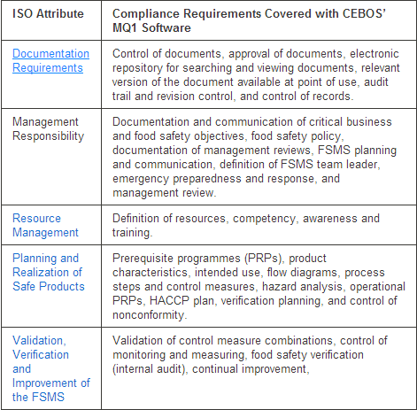
Requirements
QAD Midwest User Group

Slide 26
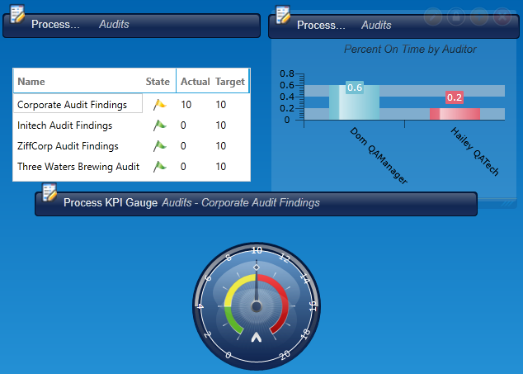
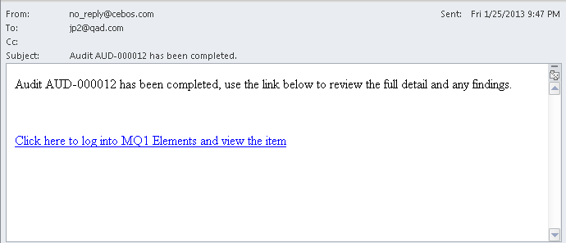
Functionality – Dashboards & Workflow
Integrating QAD and the Quality Management System
Gadgets
Drag and Drop
Graphical
Configurable

Slide 27
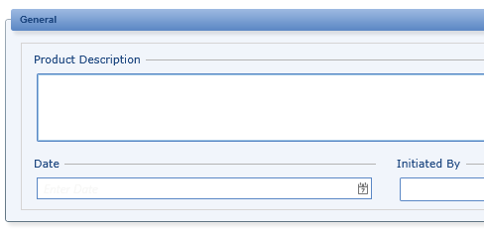
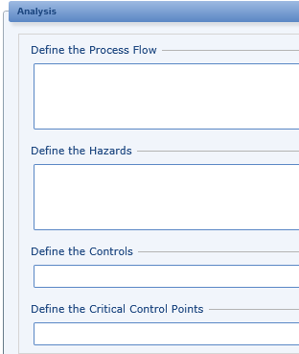
Functionality – HACCP
Integrating QAD and the Quality Management System
Central repository
Closed loop
Workflow

Slide 28
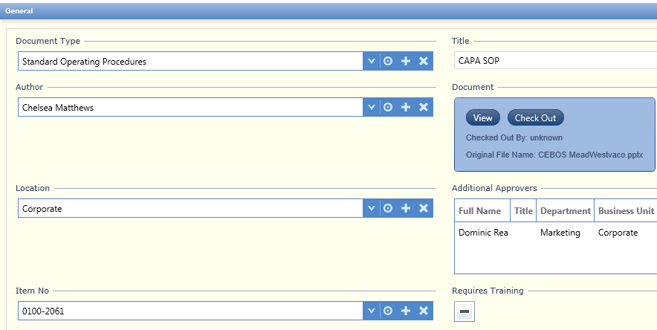
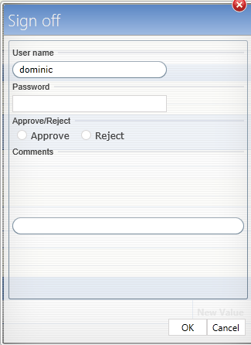
Functionality – Document Control
Integrating QAD and the Quality Management System
Central repository
Formal change request process
Automation of the change request process

Slide 29
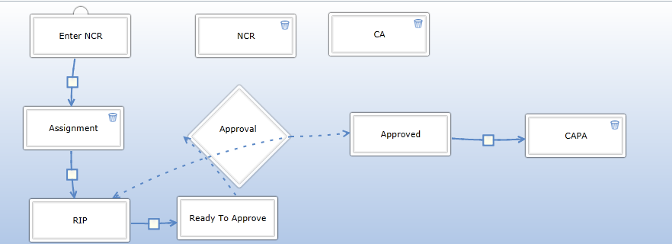
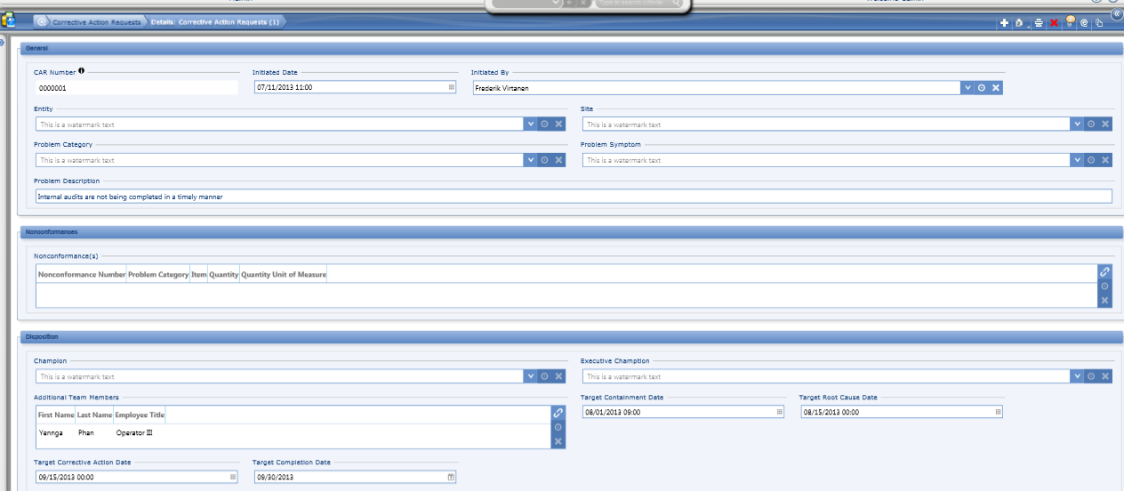
Functionality – Problem Solving
Integrating QAD and the Quality Management System
Configurable
Closed loop
Automated reporting

Slide 30
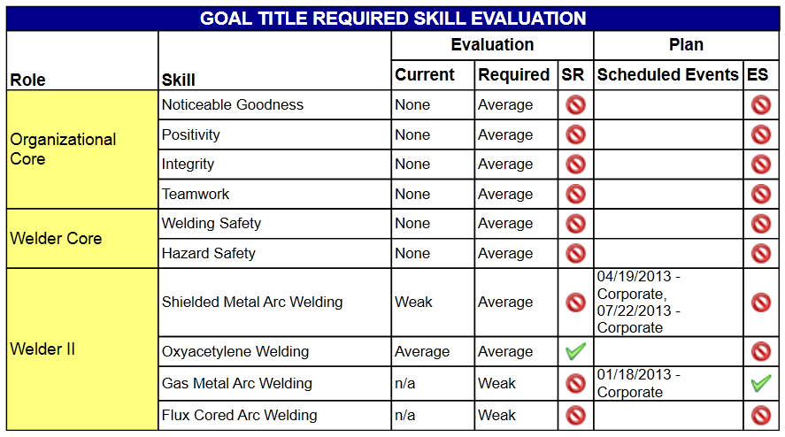
Functionality – Training Tracking
Integrating QAD and the Quality Management System
Recurring
Competency
Document control

Slide 31
Integrating QAD and the Quality Management System
E-Sync
XML Integration Functional Description
Standard XML web services
Push/Pull Data
Inspection/Inventory/CAPA
Training check
Gauge calibration check
E-Sync Functional Description
Compare data source with MQ1
Add/update records in MQ1
Employees, items, customers, etc.
System’s Integration Tools
Integration Toolkit
XML File Transfer

Slide 32
Summary
QAD Midwest User Group
Food safety a world wide issue
Many food safety and quality regulations
Laws
Requirements
Certifications
QAD has core quality solutions
Core quality
Serialization
Track & Trace
QAD has specialty solutions
CEBOS

Slide 33
Call To Action
QAD Midwest User Group
Determine your requirements
Serialization and Traceability
Quality management
Visit QAD.Com for initial information
Discuss options with your account manager
Schedule a vision engagement
Meet with QAD vertical management team
Qscan assessments
Develop quality system implementation plan
Notes:
Some information is available through the public QAD.com website. Significantly more information including free solution training is available by logging on and accessing the QAD Document Library.
If you don’t have a login ID, you can request one by clicking on the login tab which will bring up a Login ID request form. All you need to know is your QAD customer number. Or you can contact your QAD account manager and they can request an ID for you.
The QAD Vision Engagement consists of QAD & Your Company
Collaboratively identifying key process, people, and technology initiatives.
Building business cases & ROI’s for these key initiatives, and
Developing a prioritized multi-year improvement road-map
The vision engagement is offered free to you, as an investment into the partnership between QAD and your company.
The QAD Vision Engagement can also lead to a QSCAN where QAD experts work with you to put together a detailed plan to implement process, people and technology improvements.
For instance, you could engage QAD through a QSCAN to assist you with developing an approach to comply with WEEE, RoHS, Conflict Minerals, or any other regulation you face.
There is a slight charge for a QSCAN but the value you receive is definitely worth the cost.

Slide 34
Questions & Answers
QAD Midwest User Group
www.qad.com
© QAD Inc

